Slide 1
How Advisors Can Win Over Attorneys as Referral Sources
Andrew Altfest, CFP®, MBA, Founder & CEO
Martin M. Shenkman, CPA, MBA, PFS, AEP, JD
November 11, 2022

Slide 2
Andrew Altfest, CFP®, MBA
FP Alpha Founder and CEO; President, Altfest Personal Wealth Management
AdvisorHub’s 50 RIAs to Watch - 2022
Forbes Best-in-State Wealth Advisor - 2018, 2019, 2020, 2021
Forbes America’s Top Next-Gen Wealth Advisor - 2017, 2018, 2019, 2020
InvestmentNews 40 Under 40 - 2018
Chair, New York City Chapter of NAPFA
Please see the end of this presentation for additional details on awards

Slide 3
Martin M. Shenkman, CPA, MBA, PFS, AEP, JD
Author of 42 books and more than 1,300 articles
Active in numerous charities, including the American Brain Foundation and American Cancer Society
Please see the end of this presentation for additional details on awards

Slide 4
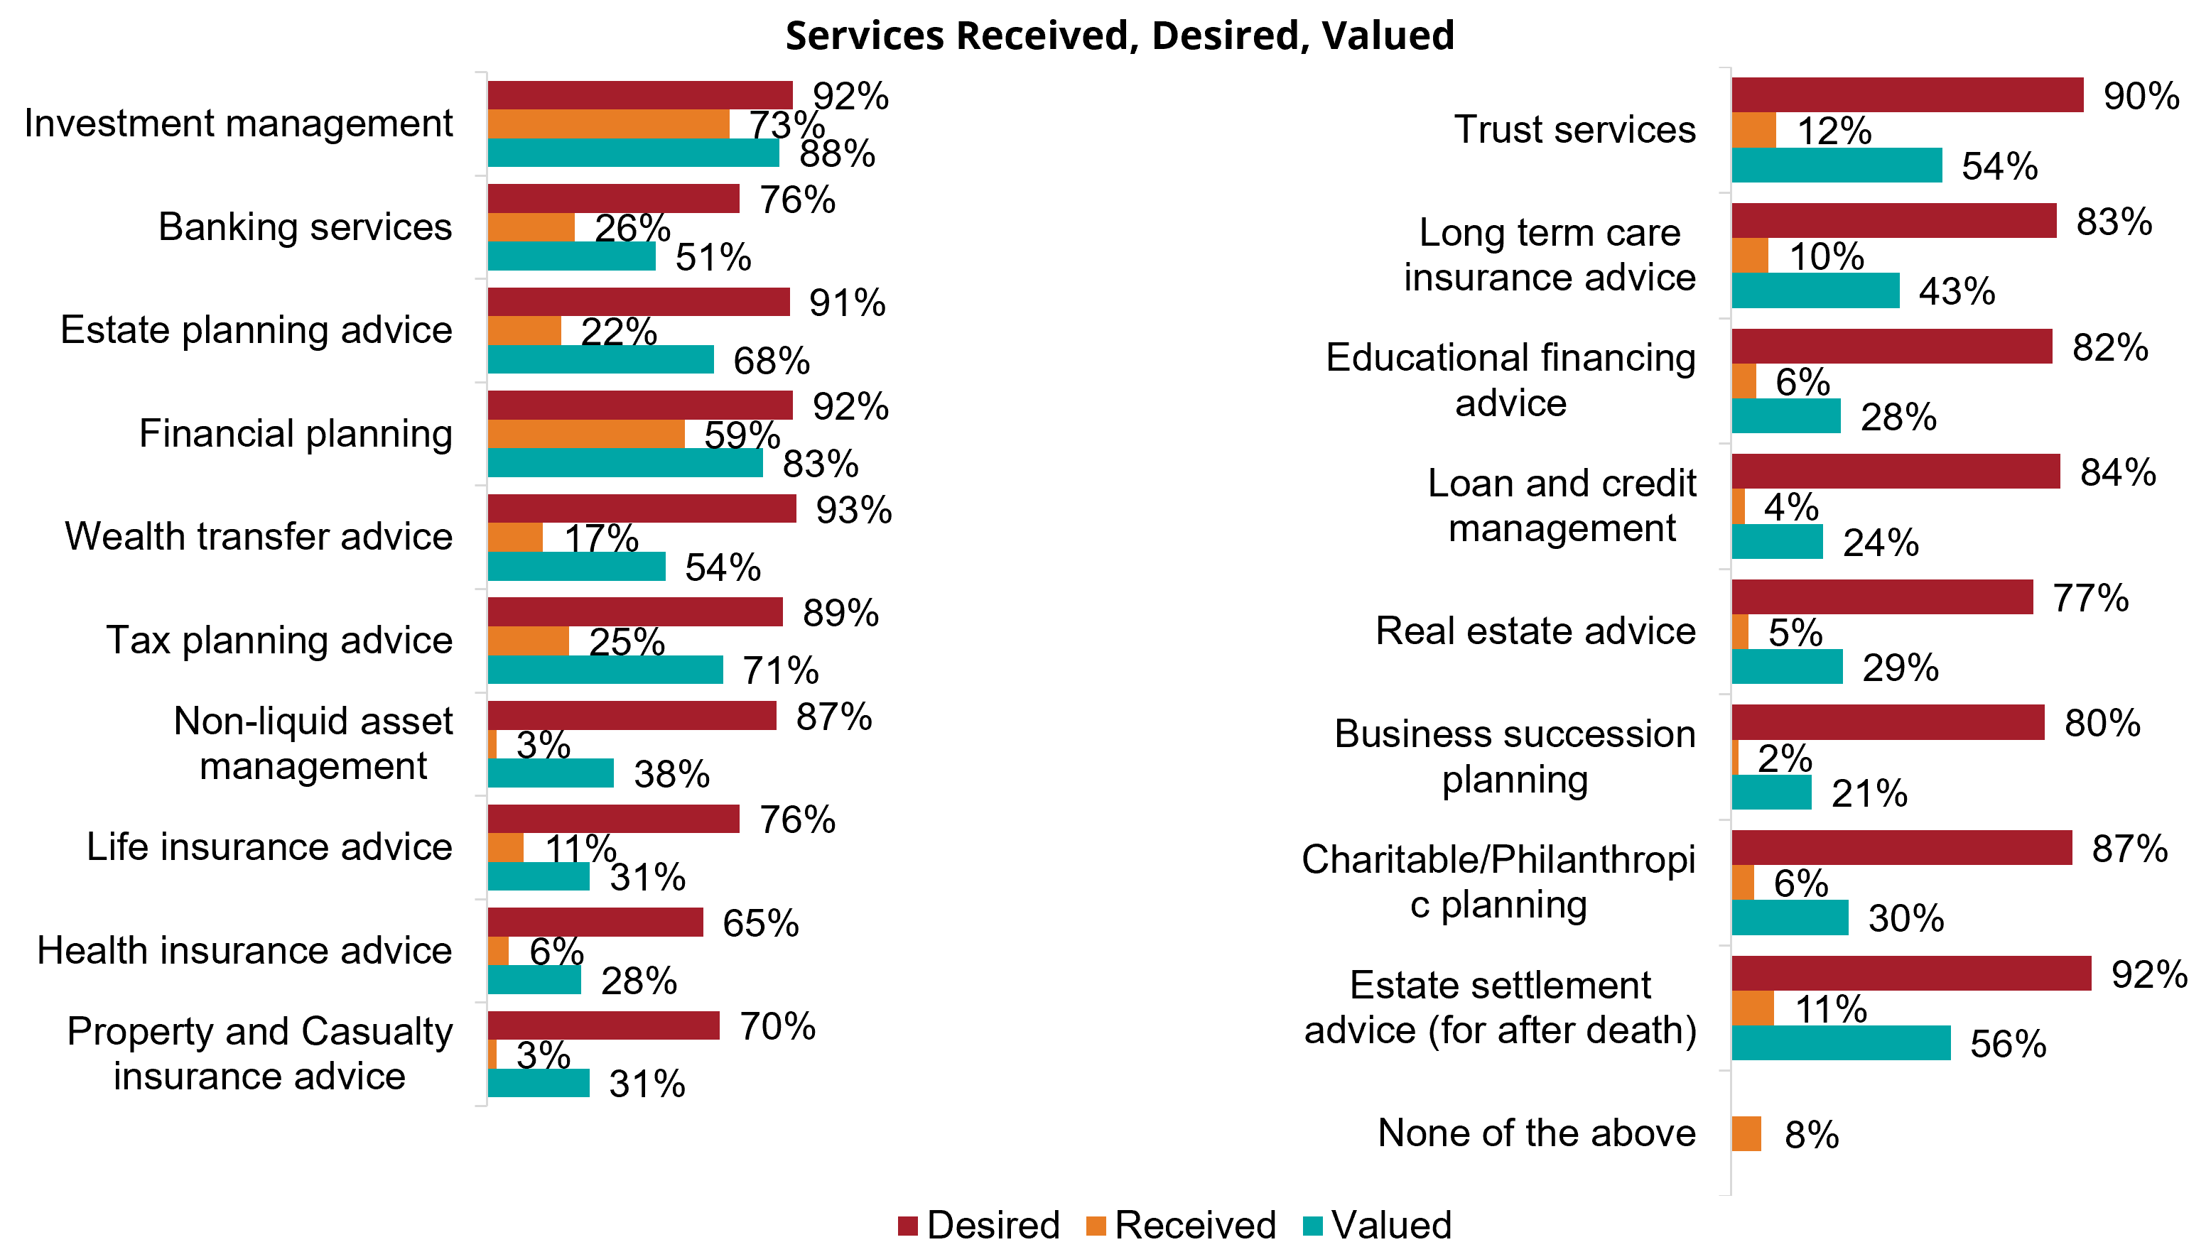
Estate planning advice and wealth transfer advice are two of the greatest gaps in services along with tax planning advice. Financial providers and advisors need to reassess their service models and determine how to close some of these gaps. This is where FP Alpha's AI technology can help advisors by instantly summarizing key data points and provide actionable estate and tax planning insights.
According to a recent Spectrem Group Survey, 91% of investors desire estate planning advice, but only 22% are receiving it, while 68% value it!

Slide 5

Your clients want Estate Planning Advice
Desired
92%
Estate Planning Advice
Received
22%

Slide 6
Agenda
Opportunities to win over attorneys as COIs
4 Common estate planning ideas to get the attorney involved
Putting the ideas into practice with technology
Wrap up with Q&A

Slide 7
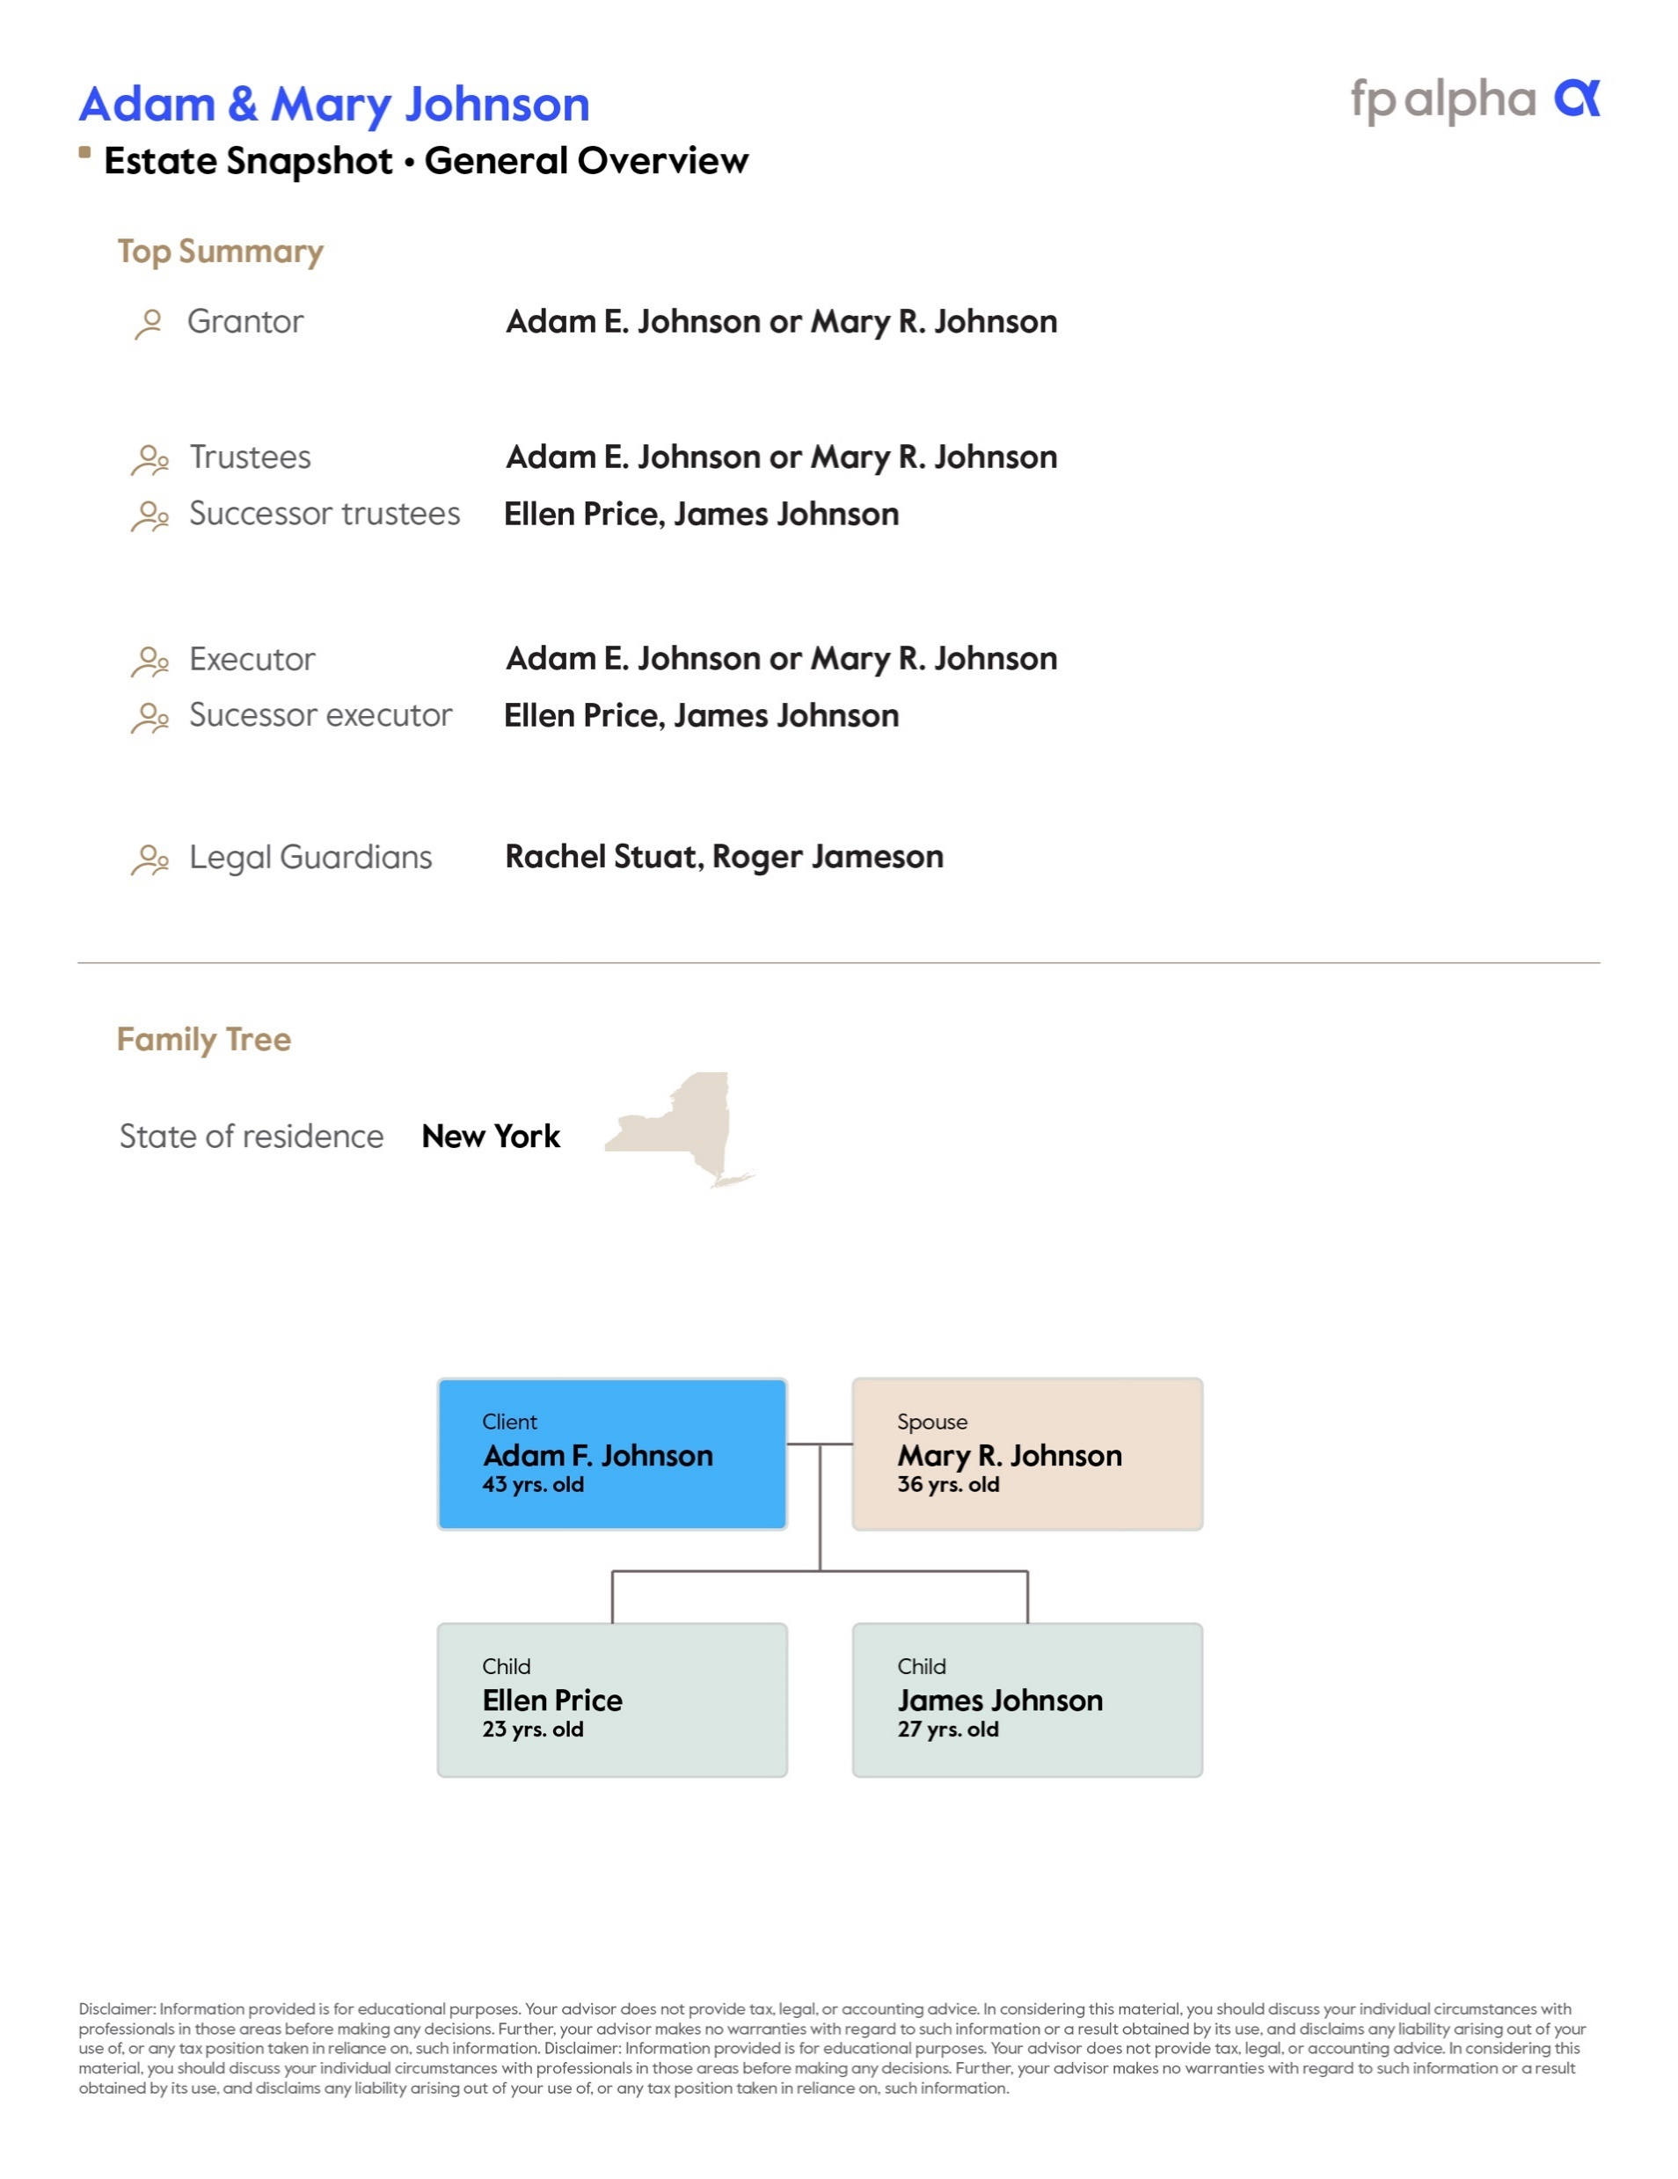
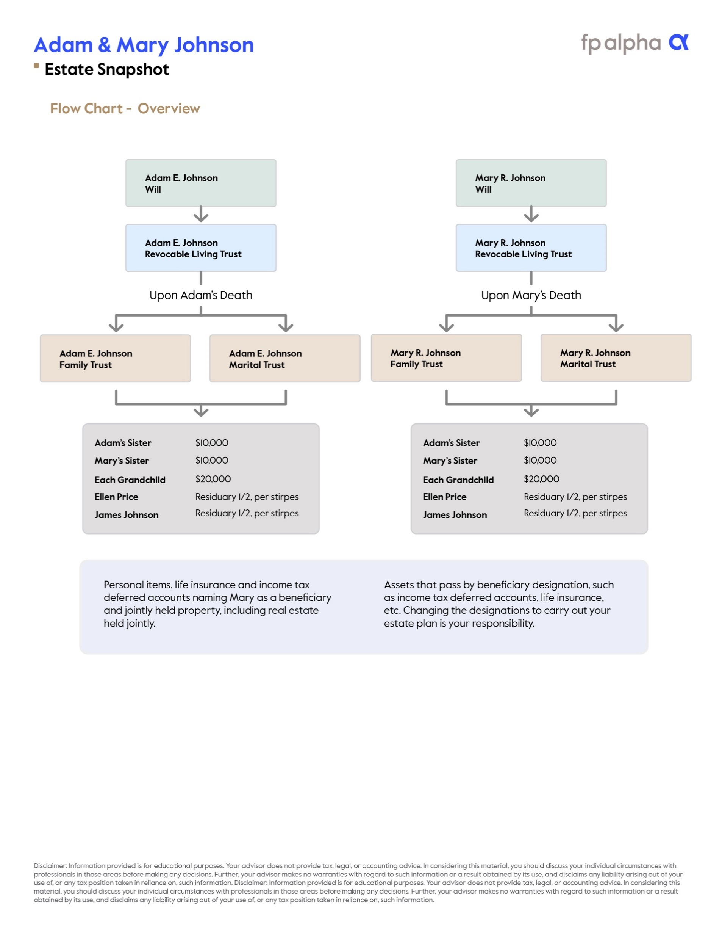
Opportunities to Win Over Attorneys as COIs
Identify opportunities through having the entire picture of your client's finances and bucketing their resources into:
Personal assets
Trust assets
Qualified plan assets
Leverage technology to expedite this process:
FP Alpha brings everything together in a summary with a visual distribution plan
You meet with your clients regularly, estate planners struggle to get their clients in the office – there's a win, win here

Slide 8
4 Common estate planning ideas: Spousal Lifetime Access Trusts (SLATs)
Opportunity #1: review whether additional insurance coverage is needed or desired # because of recent trust planning, and coordinate with your client's estate attorney
It's important to understand the pros and cons of SLATs, including when and how to use them
Technology that provides estate recommendations, like FP Alpha, can help
Pros:
Remove assets from clients’ estates before exemption drops by ½ in 2026
Provides asset protection
Trustee can make distributions to the grantor's spouse while allowing the grantor to name children or other heirs as beneficiaries
Cons:
If one spouse dies prematurely, then the other can be cut off from accessing the assets in the trust
May warrant additional insurance coverage to counteract the risk of losing access to assets, #e.g., in the event of disability, long term health care or premature death

Slide 9
4 Common estate planning ideas: Credit Shelter Trusts (bypass trusts)
Opportunity #2 : Keep an eye out for clients with bypass (a/k/a credit shelter or “family”) trusts that do not have a legal or financial# reason to keep the trust and consult with their estate attorney
Once popular credit shelter trusts are increasingly irrelevant
The increase in estate tax exemptions to almost $13 million (2023) means many do not benefit from having trust assets bypass their estate
Result: Minimal to no tax savings benefit while incurring the cost to administer the trust and file trust income tax returns but for some losing the opportunity for a basis step up on death

Slide 10
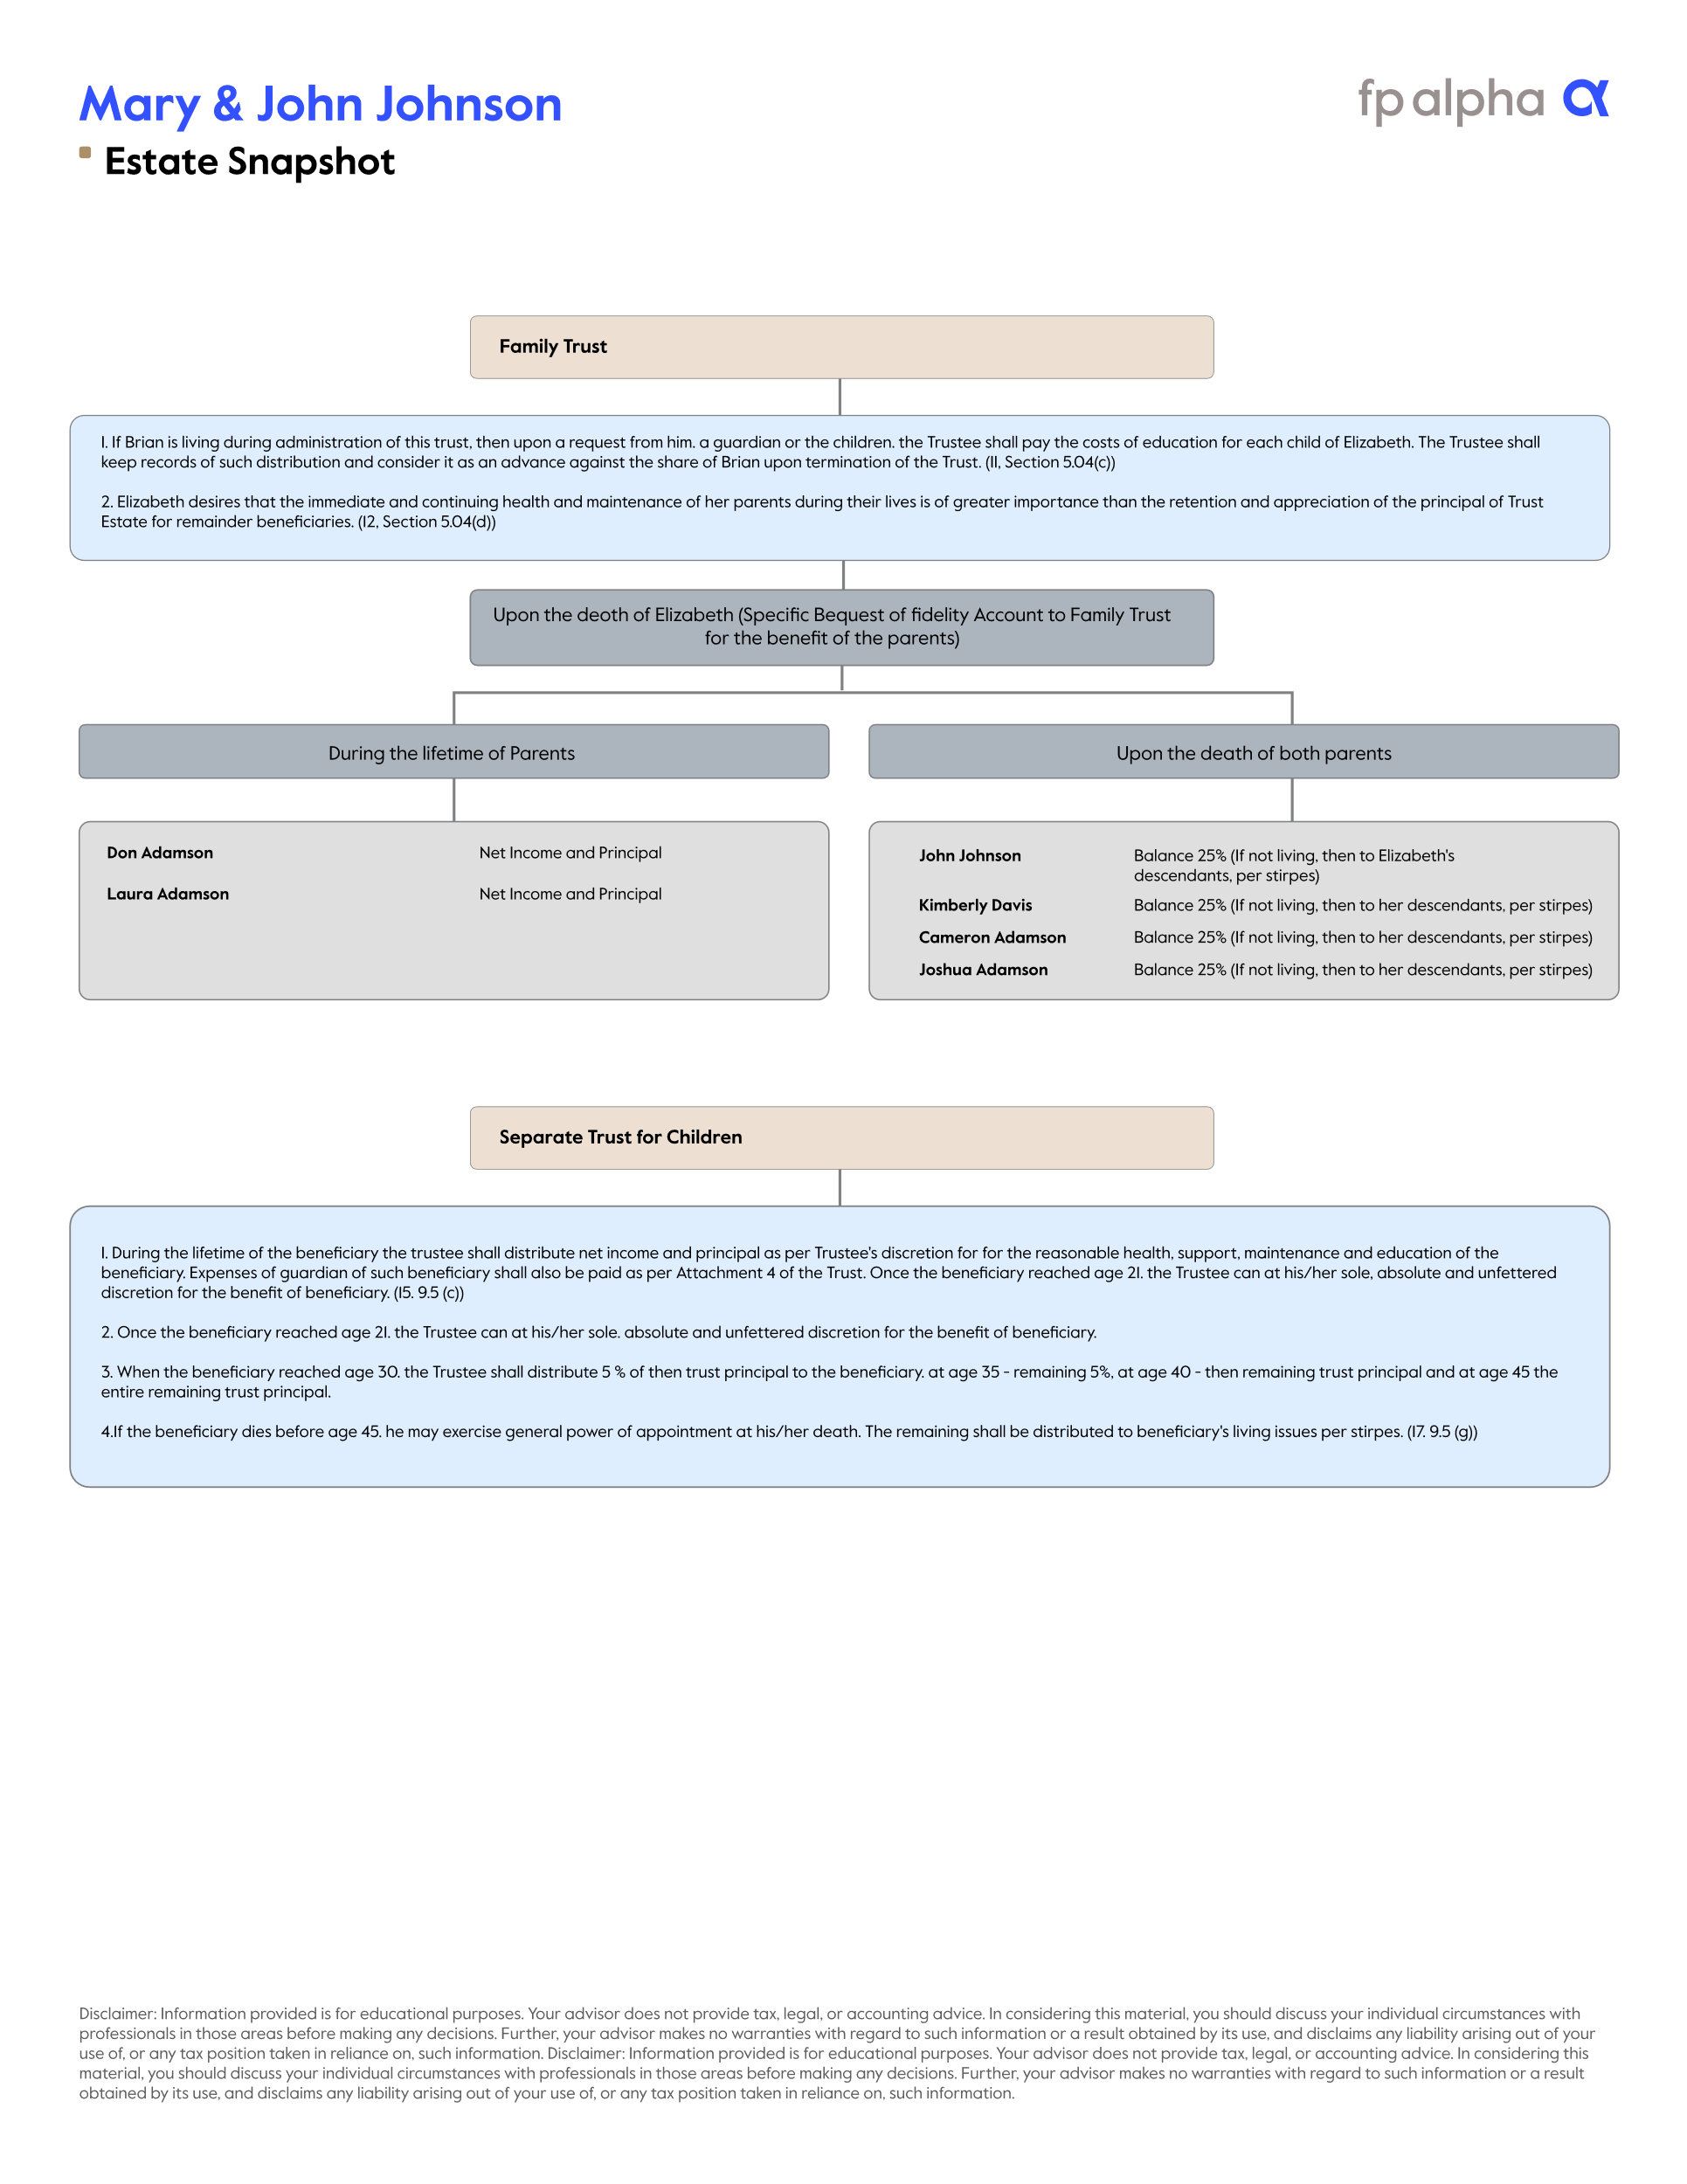
4 Common estate planning ideas: Decanting Old Trusts
Opportunity #3 : Consider whether your client needs to decant an old trust and reach out to their estate attorney
Decanting is when you merge old trusts into new ones
Typically done to extend the life of the trust past an age threshold for the beneficiaries where all assets in the trust must be distributed – Example many old trusts end at age 35 and give assets to the beneficiaries. That destroys asset/divorce protection and any estate tax benefits.
Be aware of the "HEMS" standard
FP Alpha can provide distribution plans that help you spot opportunities to decant old trusts

Slide 11
4 Common estate planning ideas: Protecting Aging Clients from Financial Abuse
Opportunity #4 : Protecting aging clients from financial abuse. Review the clients durable power of attorney, revocable trust, healthcare proxy, and other documents and consider updating with an estate attorney to make sure the correct protection is in place for the client.
As clients age, have assets been consolidated, bill pay automated, an advisor team organized for support (which may include a care manager at some point)?
If the documents are more than 3-5 years old, or if major events have occurred, an update is likely in order.
Review all the agents named under the various documents - do they make sense?
Relationships change, people move, “stuff” happens, and too often the clients do not even realize they need to return to their attorney for updated, new, or additional documents.
Consider who the client informed you of to call if you become concerned about elder abuse, who the client named to receive notice on failure to pay for a long-term care policy, or to interact with Social Security.
Are those people all consistent with each other and the people named in the legal documents? If not, why?

Slide 12
Putting the ideas into practice with technology

Slide 13

Current Estate Planning Process
Notes:
Hours and hours or time. Reading documents, Not everyone went to law school.

Slide 14


Estate Snapshot

Slide 15

With the Estate Snapshot
You are saving time & money
by 100x

Slide 16


Slide 17
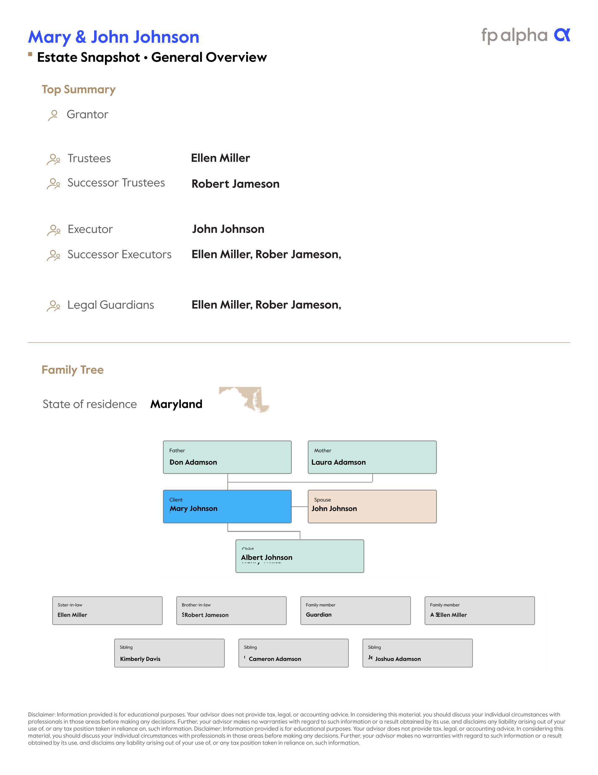

Slide 18
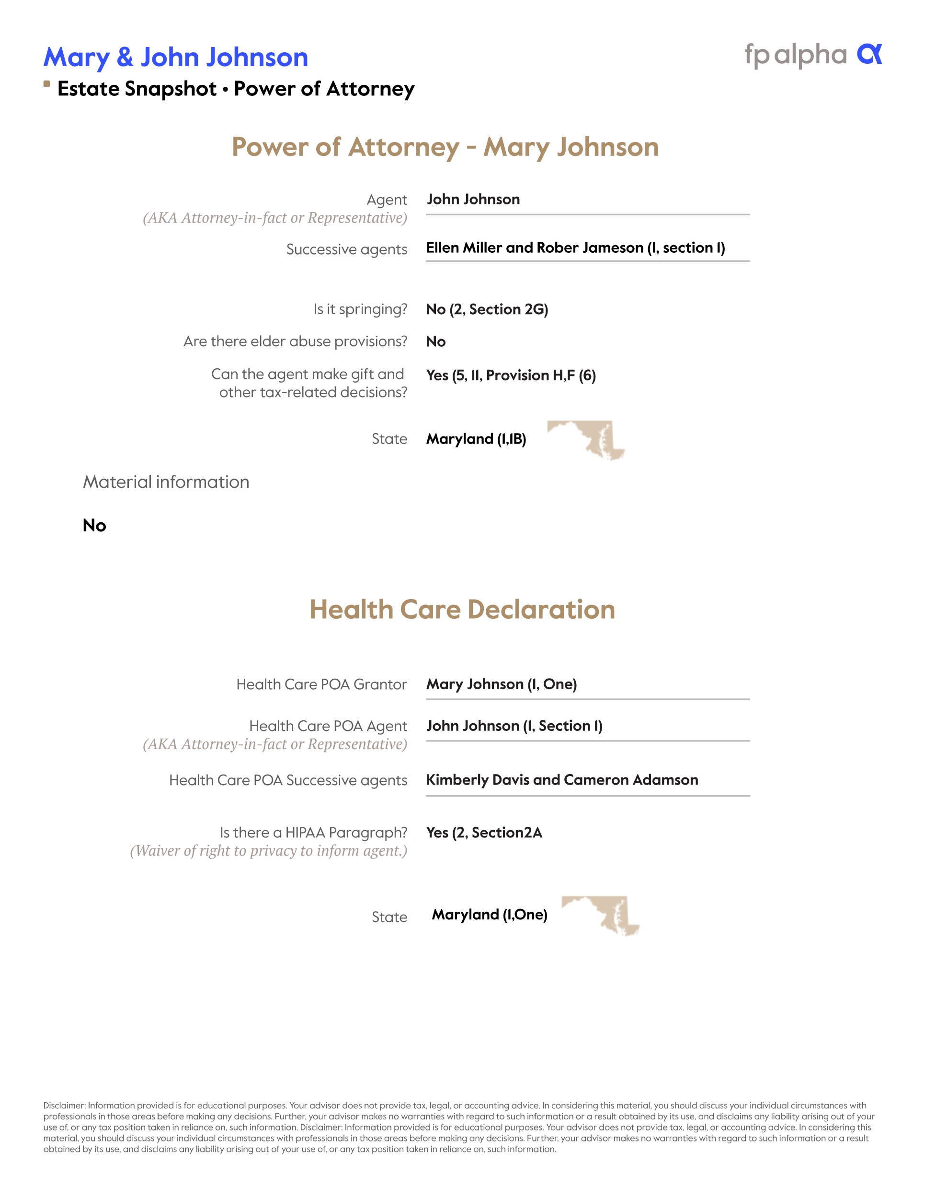

Slide 19
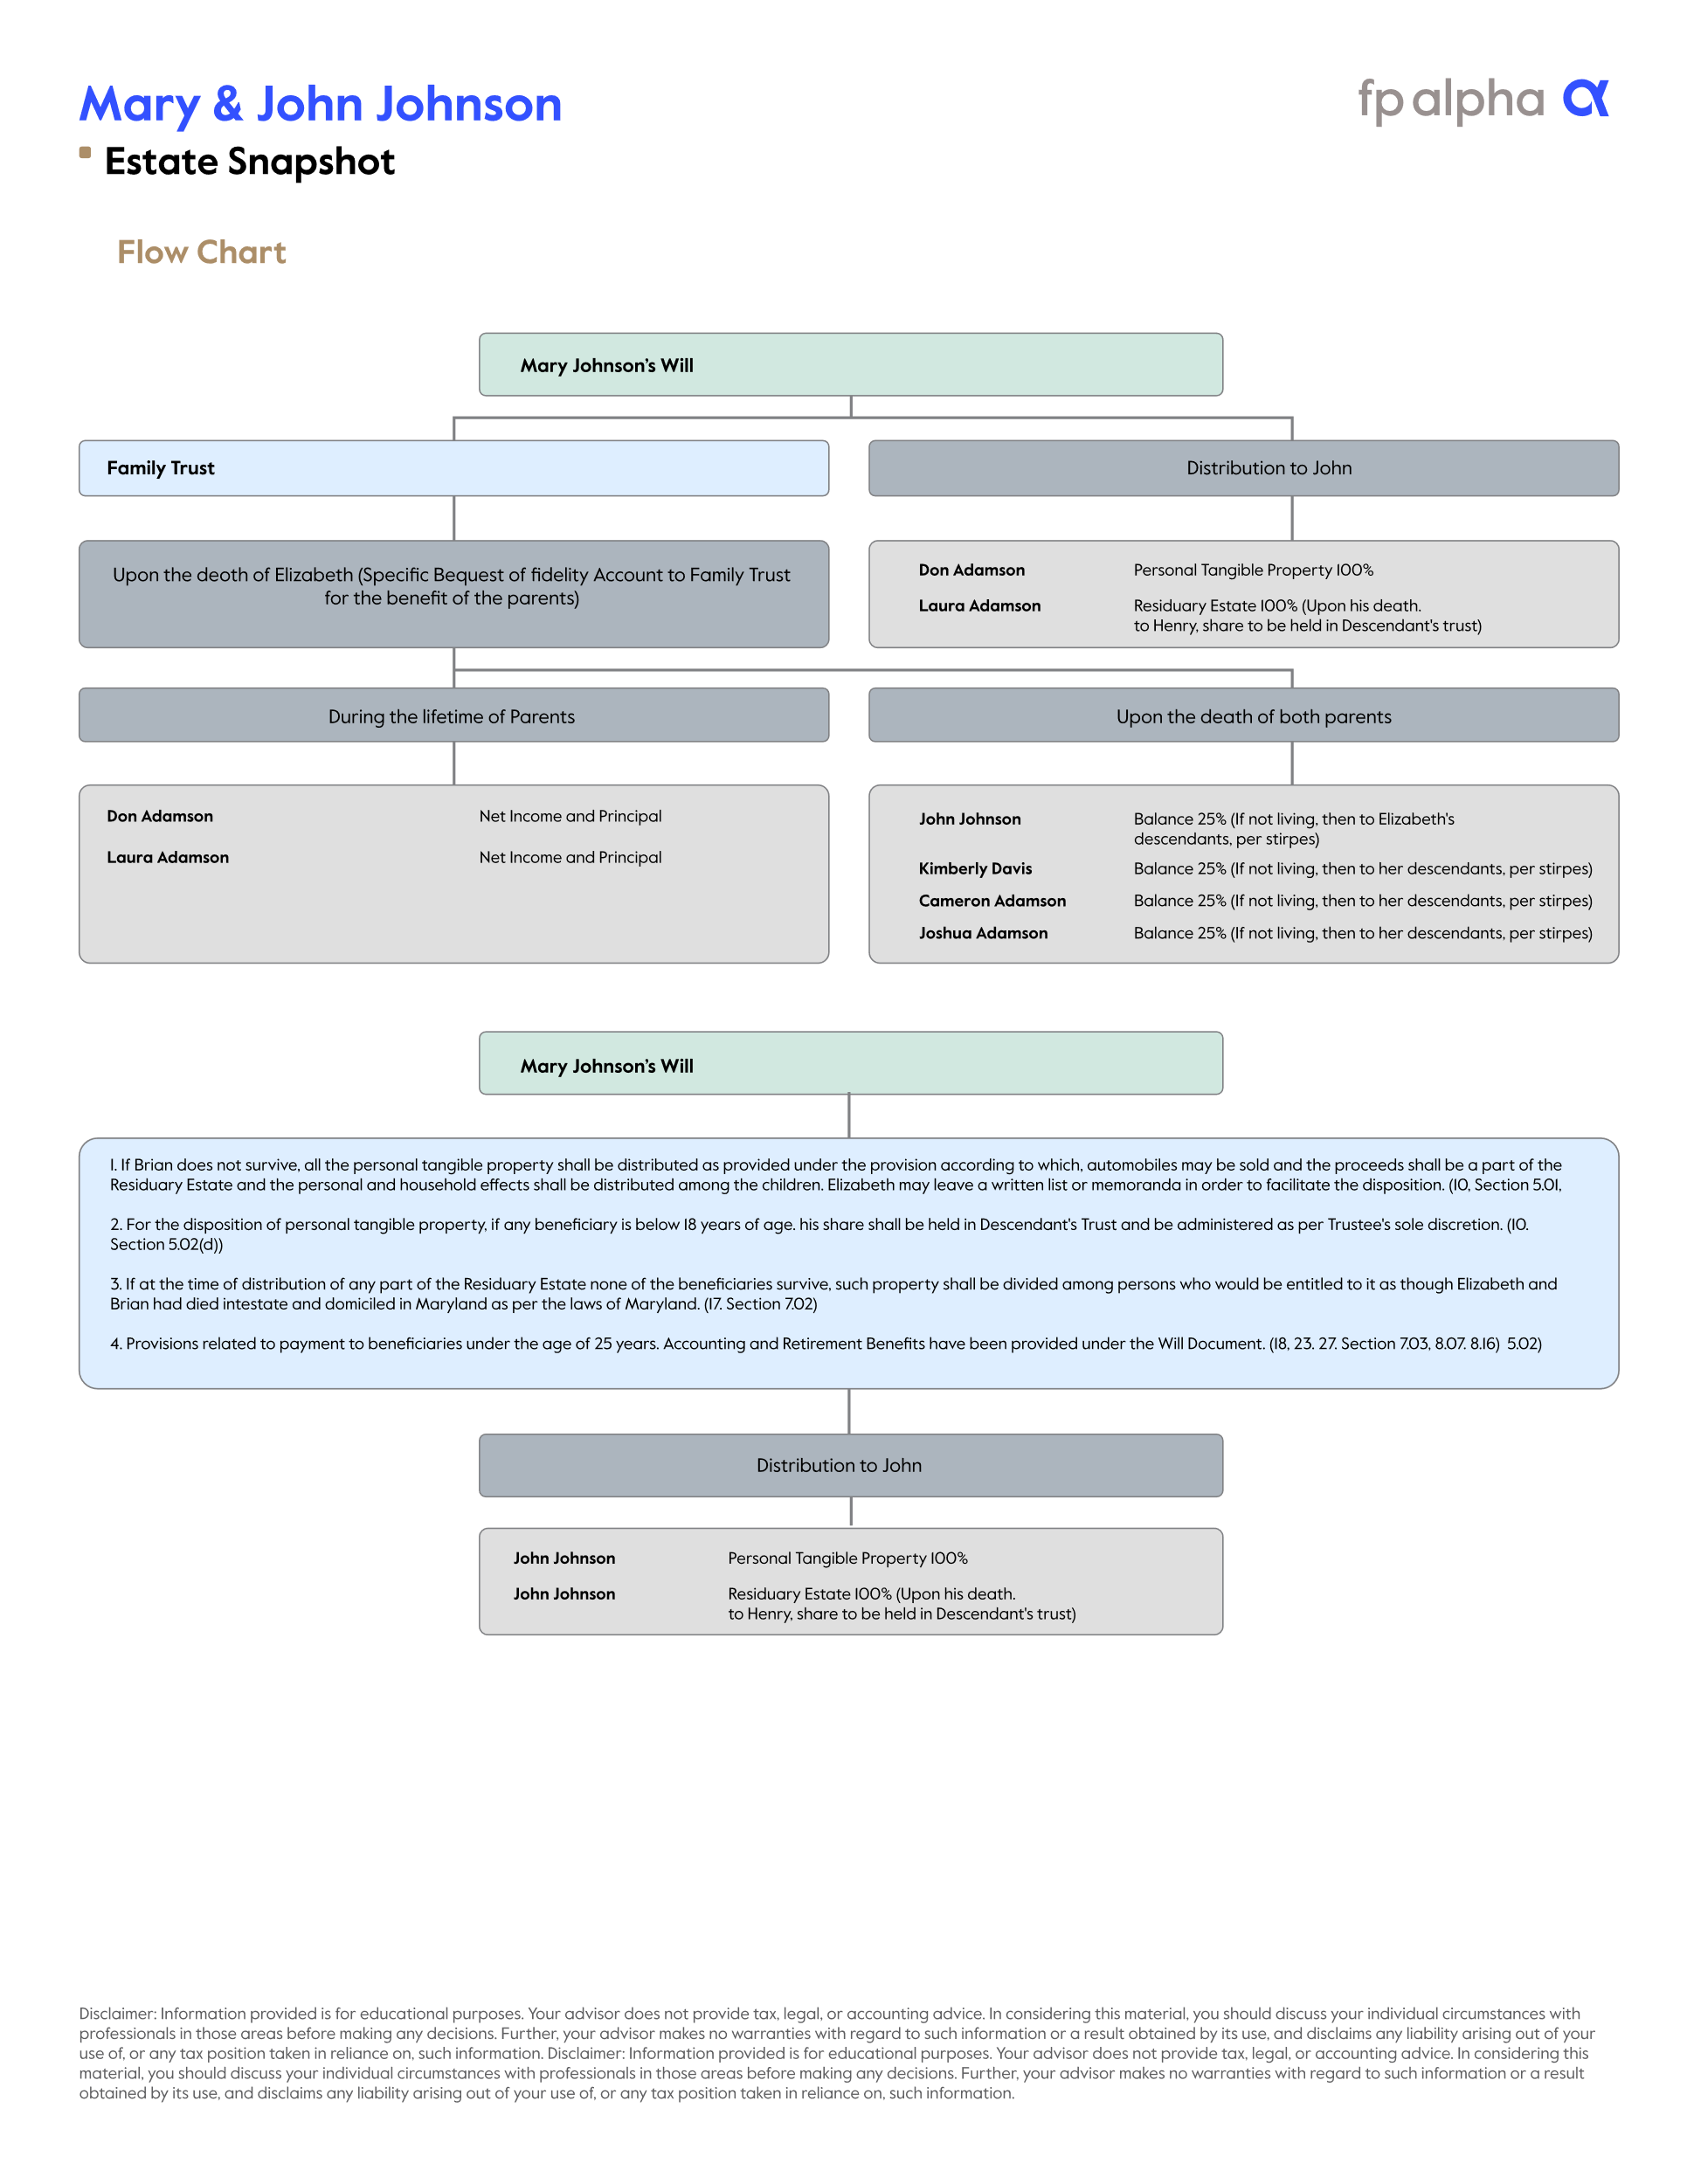

Slide 21
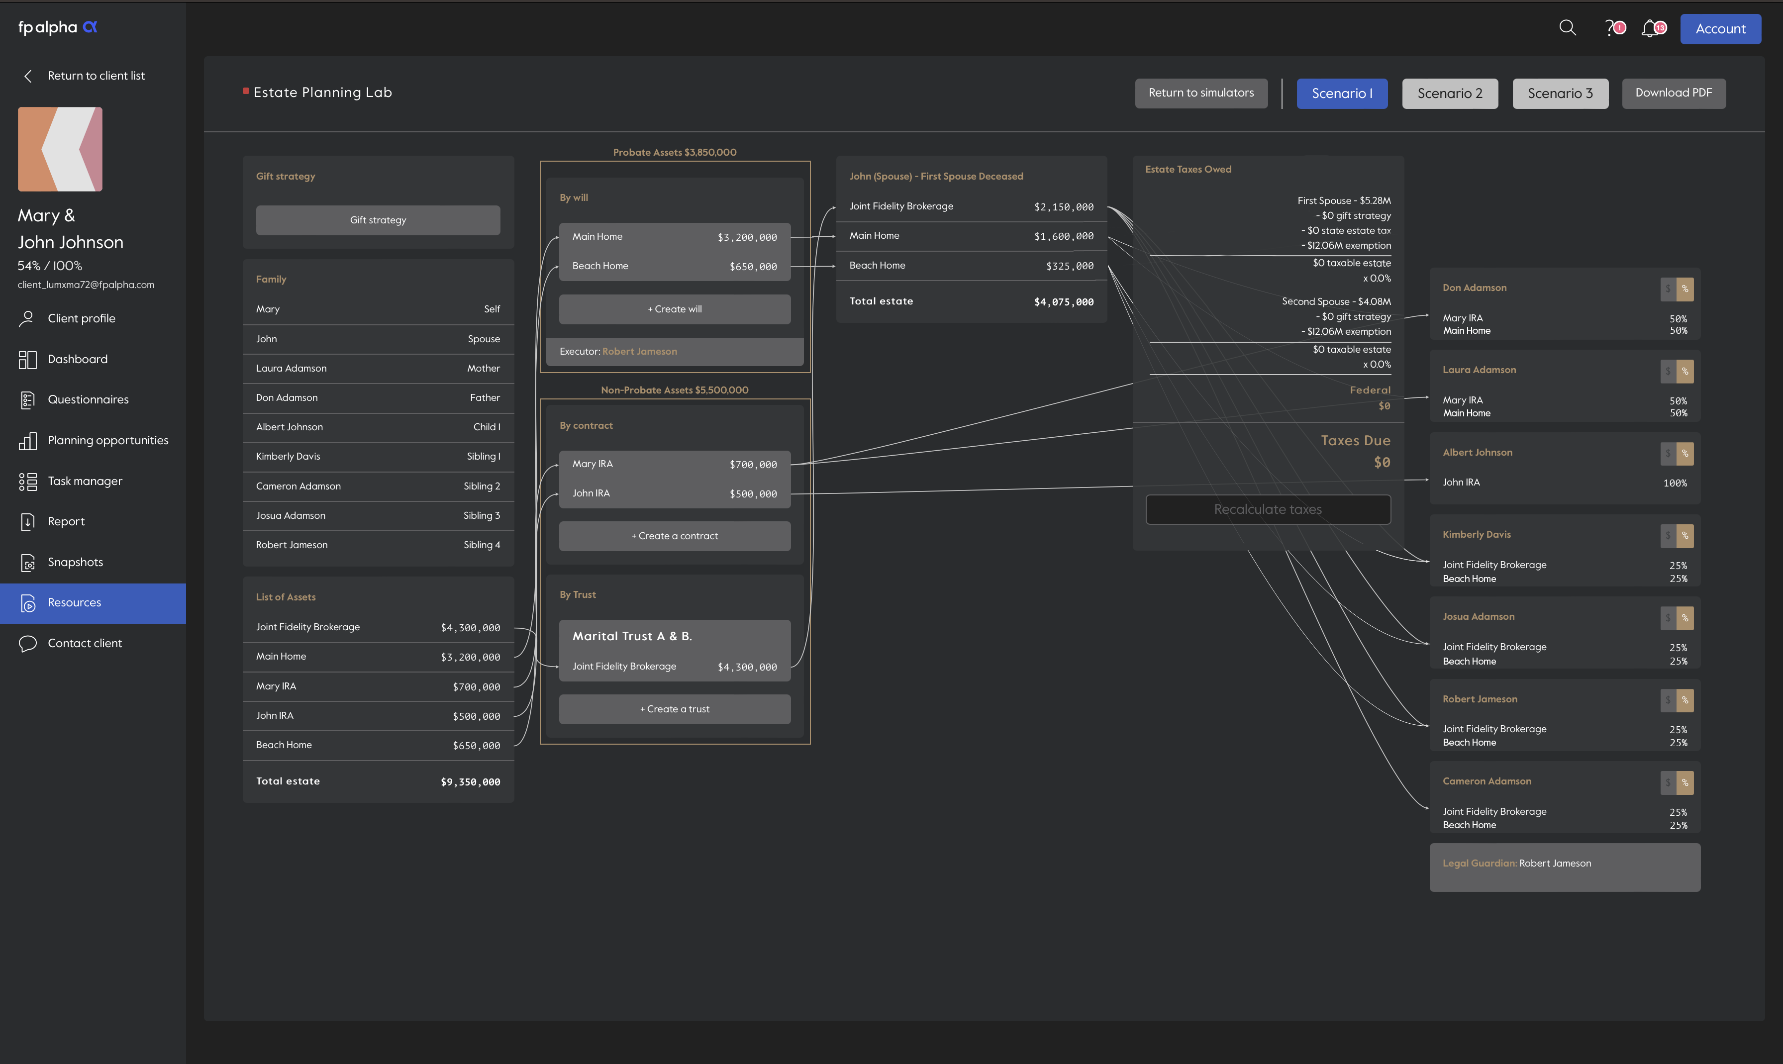

Slide 22
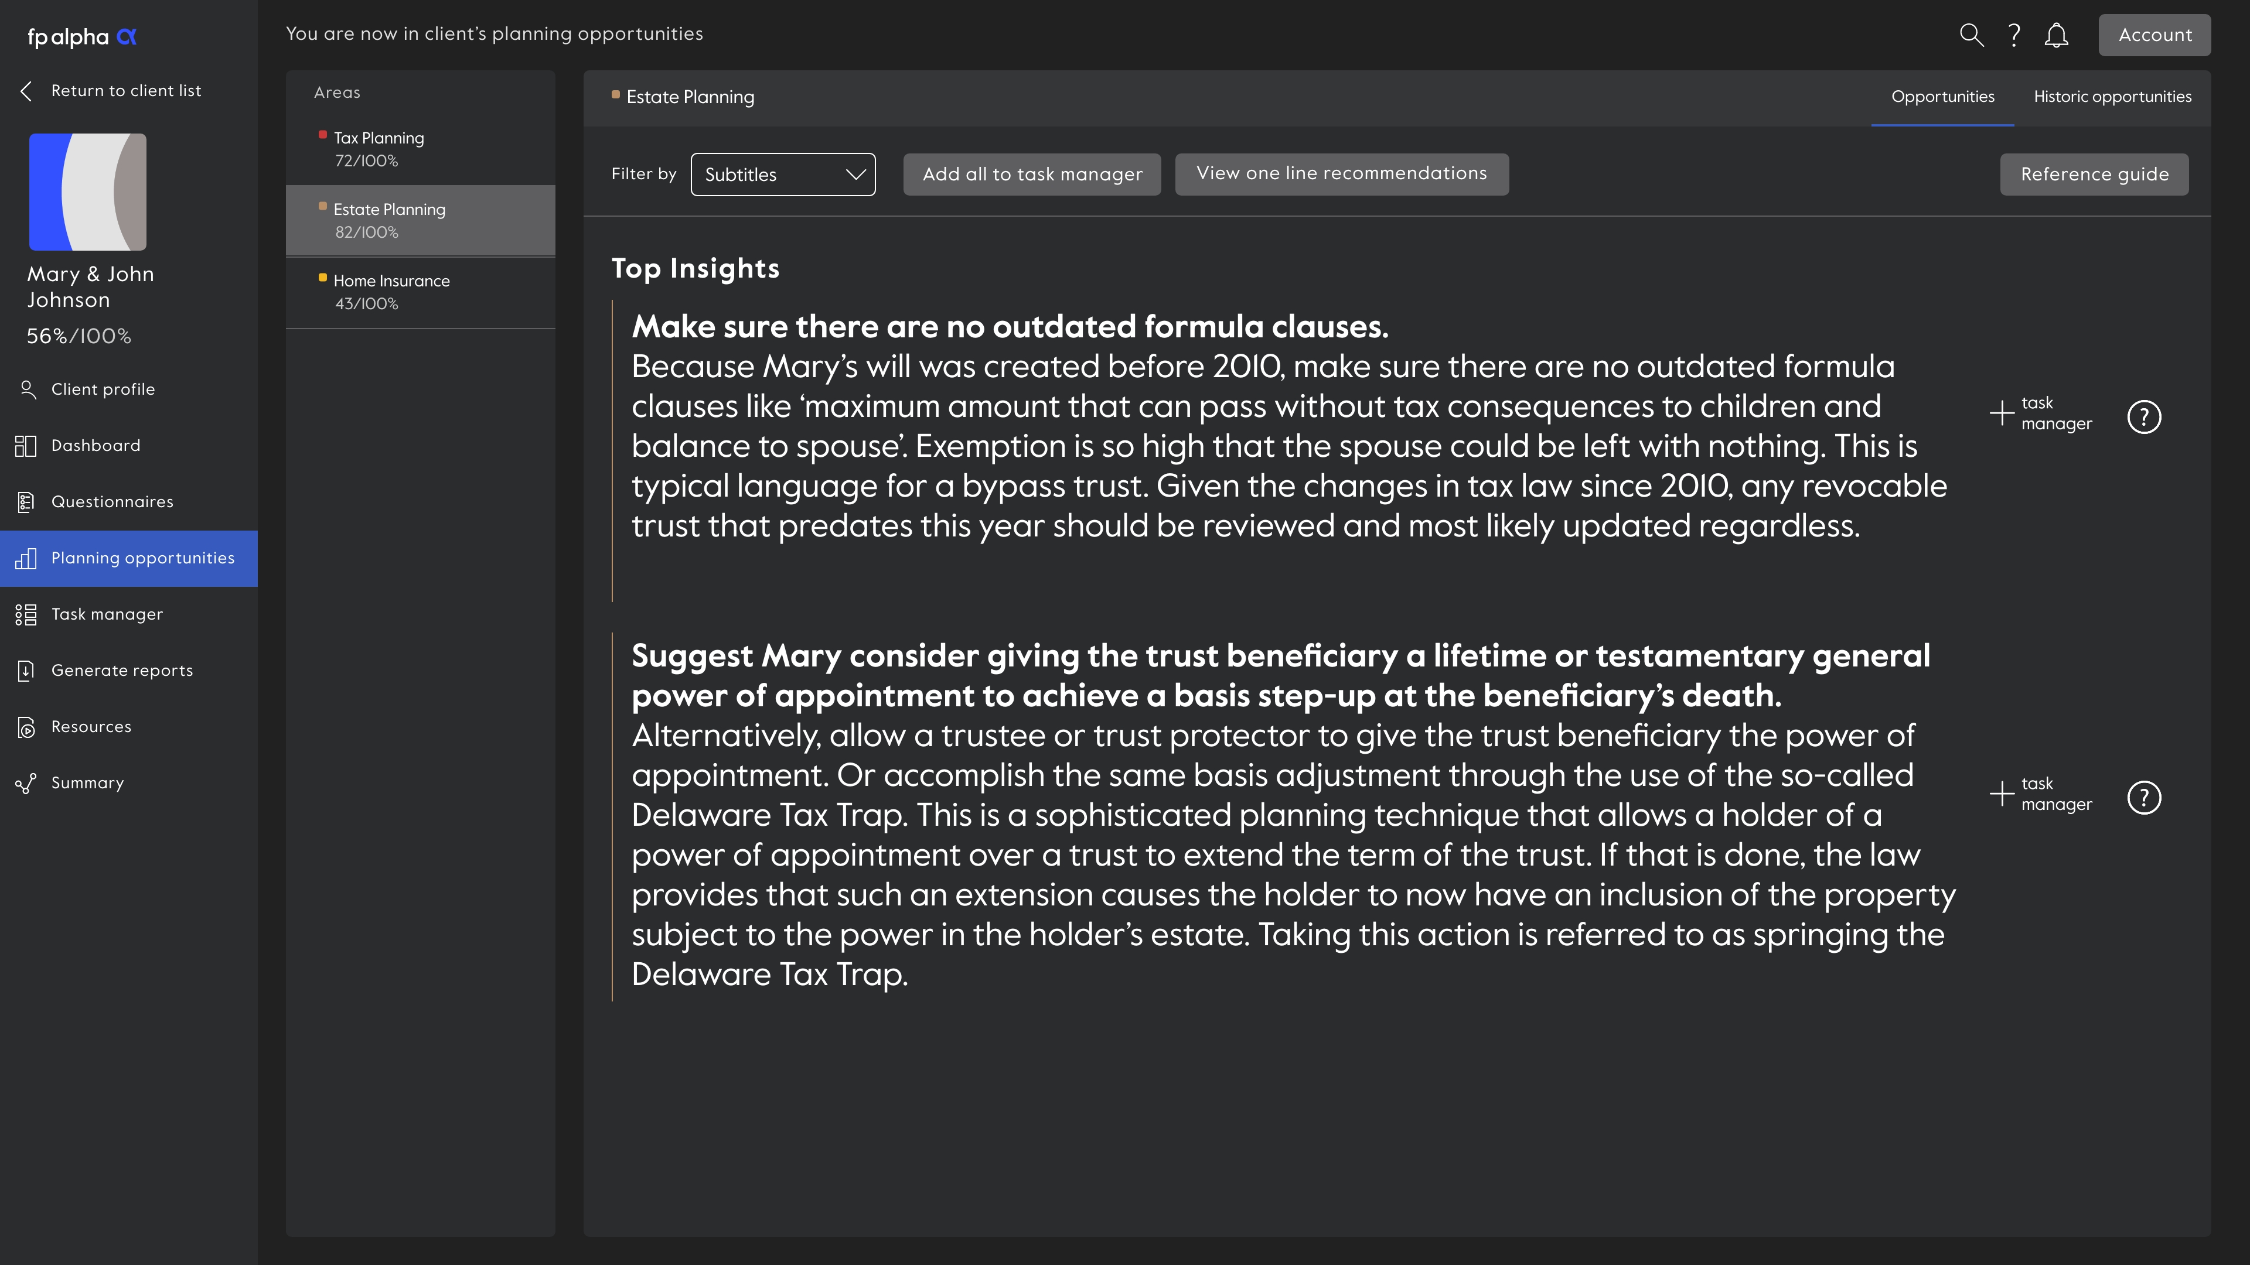
Recommendations

Slide 23
Where does
fit in your tech stack?

Slide 24
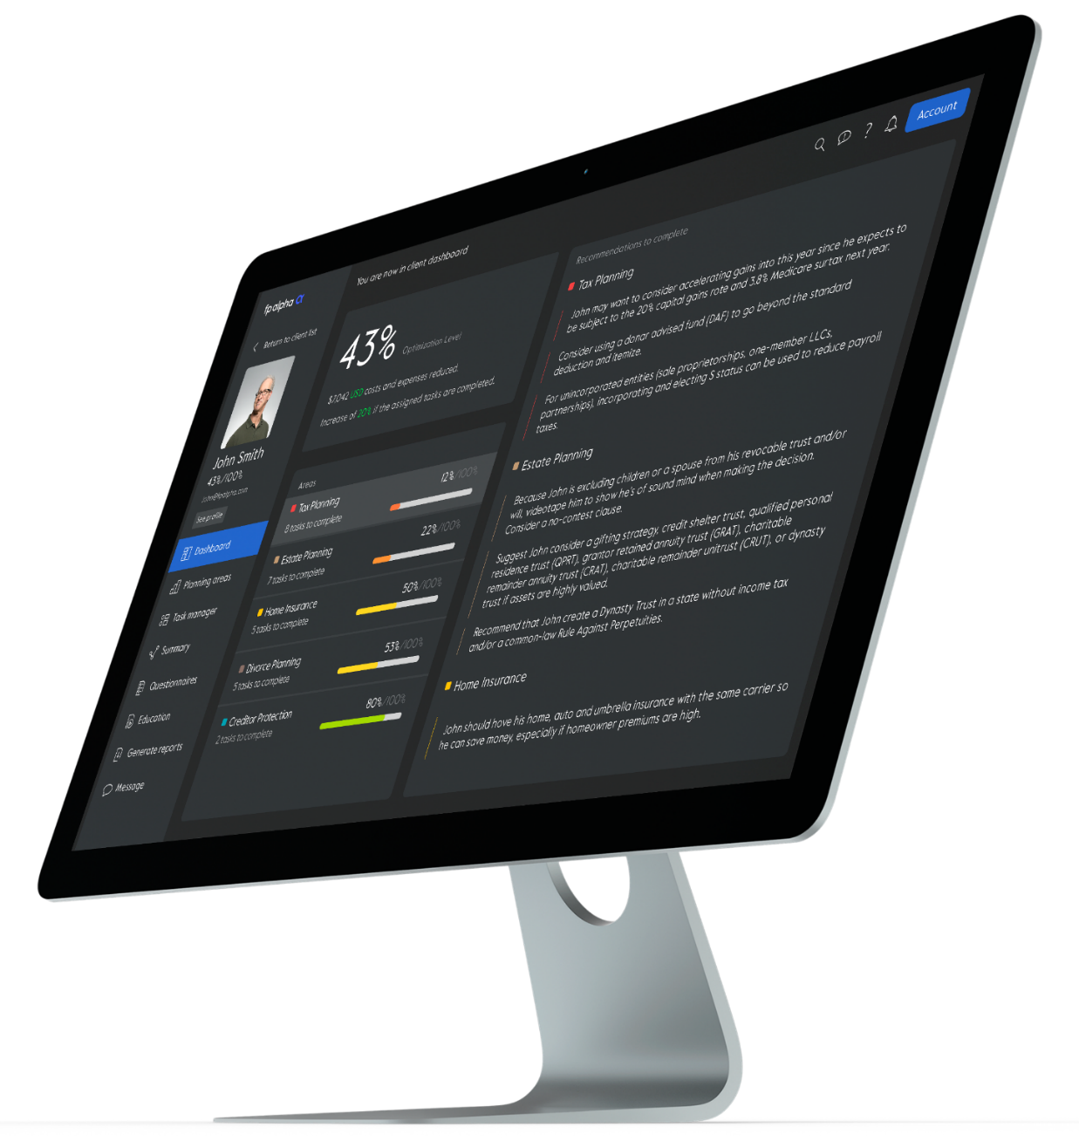
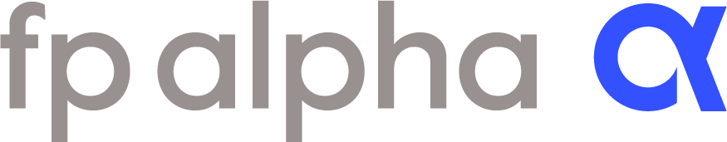
For a Demo
sales@fpalpha.com
fpalpha.com
For Current Users
support@fpalpha.com
dgilpatrick@fpalpha.com

Slide 25
Advisorhub’s 50 RIAs to Watch. These fifty advisors have assembled efficient and productive teams that have achieved scale without compromising their level of service while maintaining healthy growth.
Forbes’ Best-In-State Wealth Advisors, developed by SHOOK Research, is based on an algorithm of qualitative criteria, mostly gained via phone and in-person due diligence interviews, and quantitative data. Advisors who are considered have a minimum experience of seven years. The algorithm weights factors like revenue trends, assets under management, compliance records, industry experience and those that encompass best practices in their business and in their approach to working with clients. Portfolio performance is not a criteria due to varying client objectives and lack of audited data. There is no fee to participate.
Forbes’ ranking of America’s Top Next-Generation Wealth Advisors, developed by SHOOK Research, is based on an algorithm of qualitative and quantitative data, rating thousands of professionals with a minimum of four years relevant experience. Factors reviewed include revenue trends, assets under management, compliance records, industry experience and best practices. Also, interviews are held via telephone and in-person conversations. Portfolio performance is not a criteria due to varying client objectives and lack of audited data. There is no fee to participate.
The InvestmentNews 40 Under 40 program recognizes and celebrates up-and-comers in the financial advice industry. Each year, our editorial team reviews more than 1,000 nominations to create a list of 40 outstanding financial advisers, or industry professionals supporting advisers, who are 39 or younger. Honorees are judged on their accomplishments, contribution to the industry, leadership and promise.

