Slide 1

2022 Consumer Webinar Series for National Estate Planning Awareness Month: Financial Planning The Foundation of Your Estate Plan: Part 1 Kit MacNee

Slide 2
General Disclaimer
The information and/or the materials provided as part of this program are intended and provided solely for informational and educational purposes. None of the information and/or materials provided as part of this power point or ancillary materials are intended to be, nor should they be construed to be the basis of any investment, legal, tax or other professional advice. Under no circumstances should the audio, PowerPoint or other materials be considered to be, or used as, independent legal, tax, investment or other professional advice. The discussions are general in nature and not person specific. Laws vary by state and are subject to constant change. Economic developments could dramatically alter the illustrations or recommendations offered in the program or materials.

Slide 3
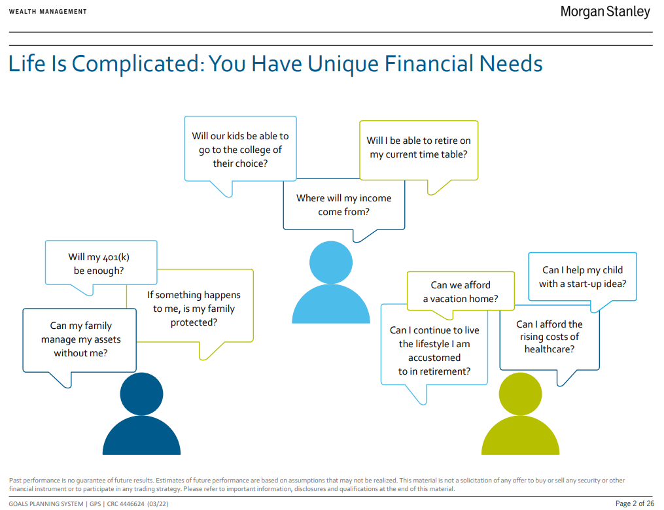

Slide 4
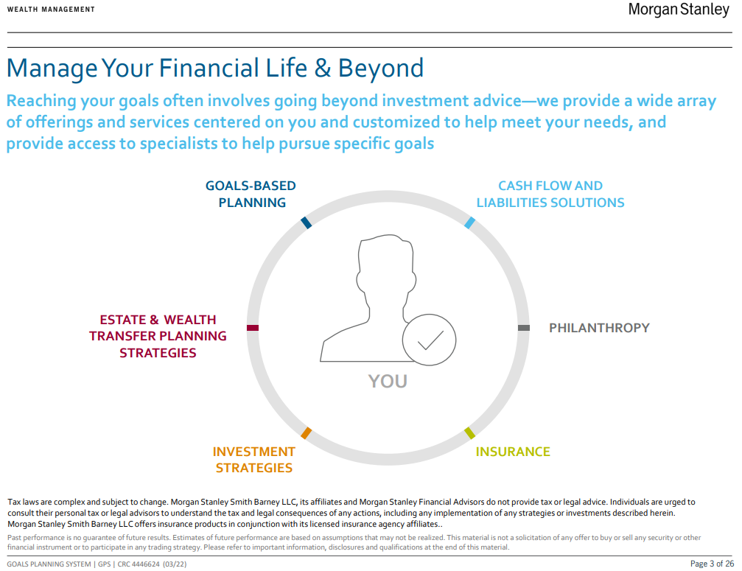

Slide 5
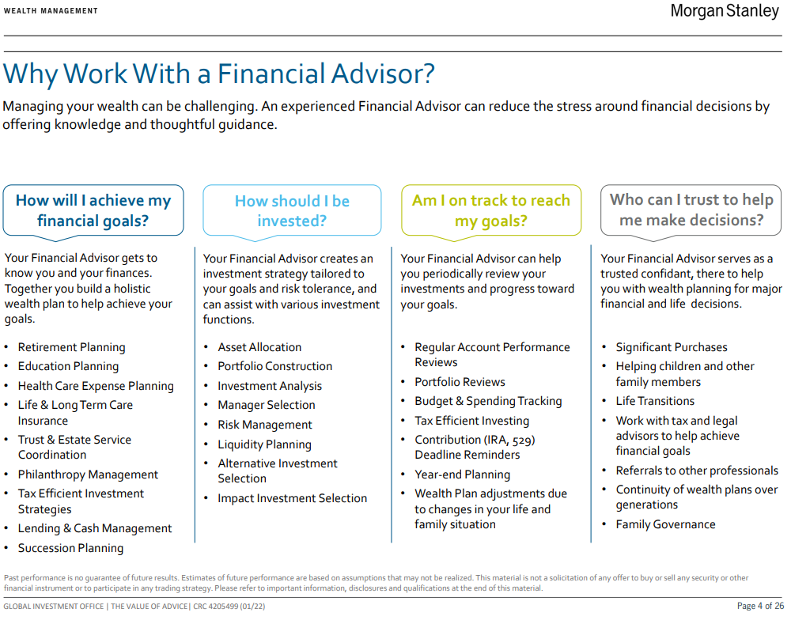

Slide 6
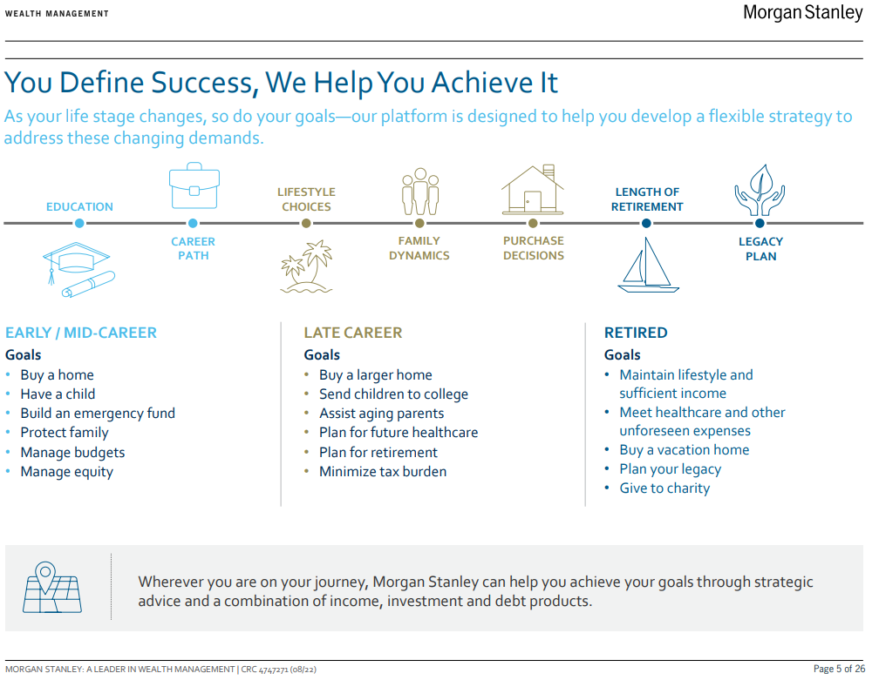

Slide 7
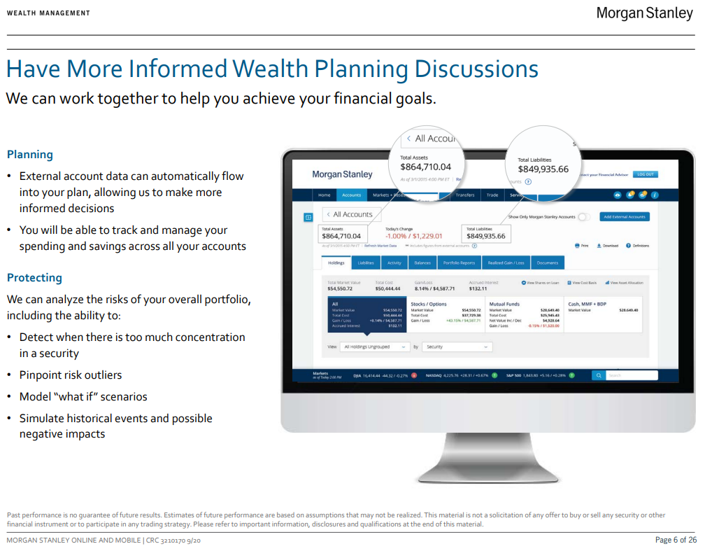

Slide 8
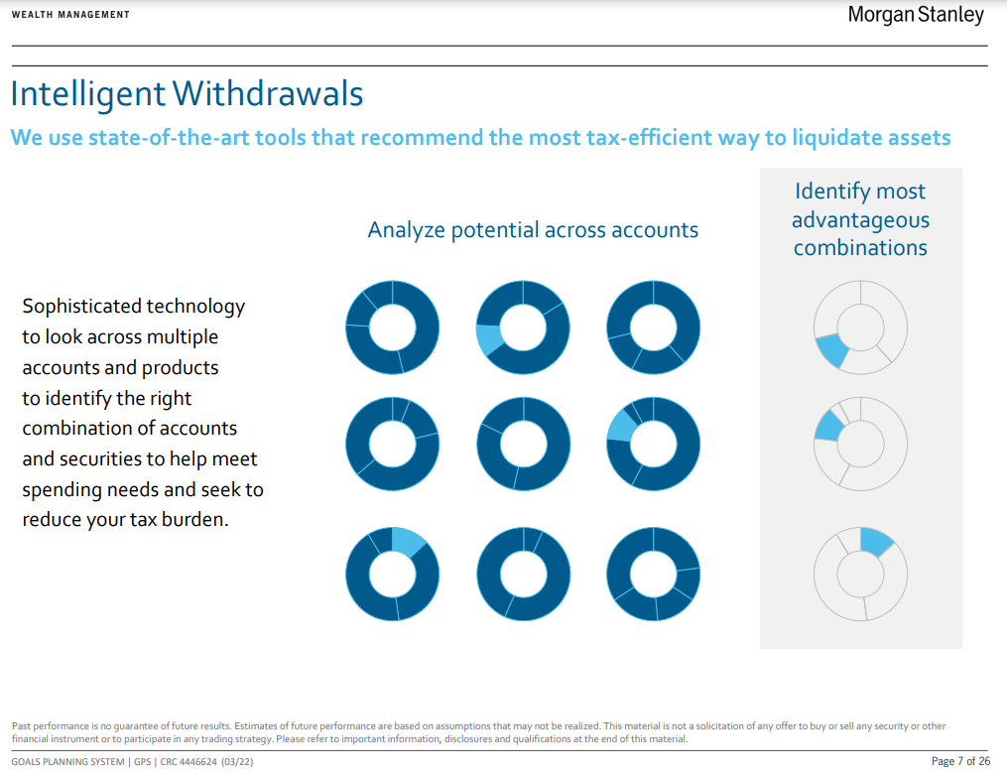

Slide 9
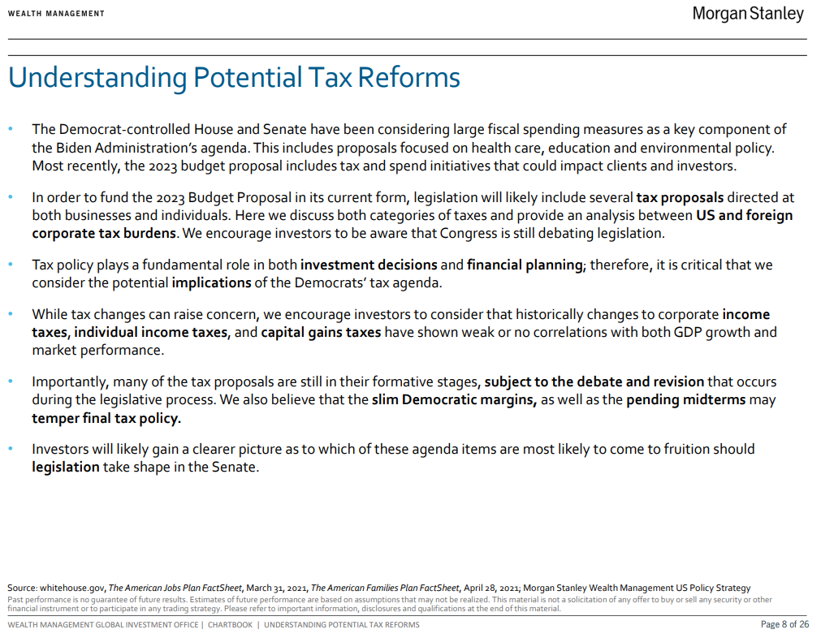

Slide 10
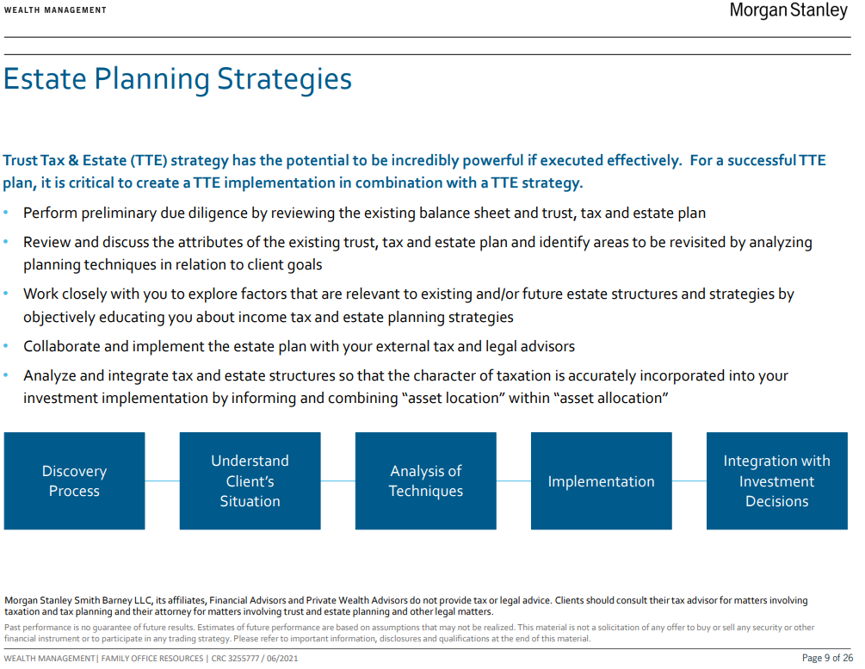

Slide 11
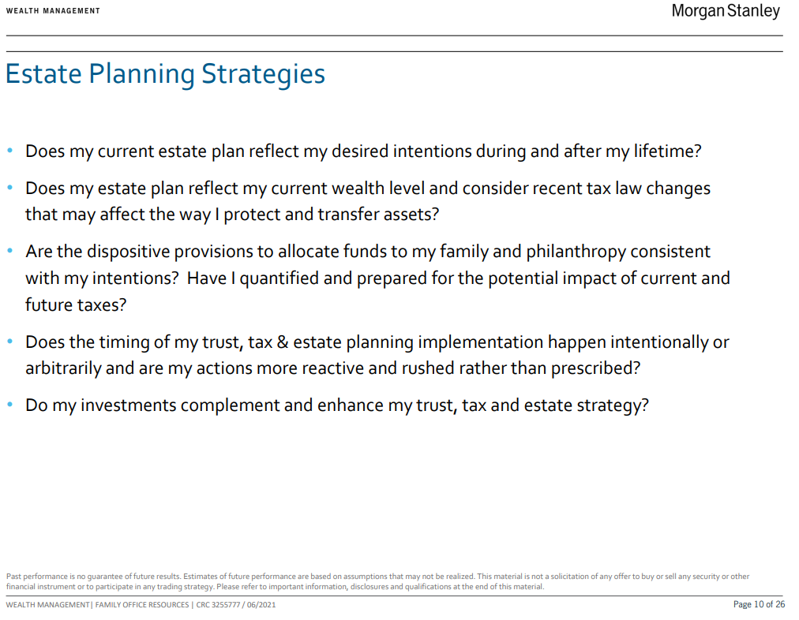

Slide 12
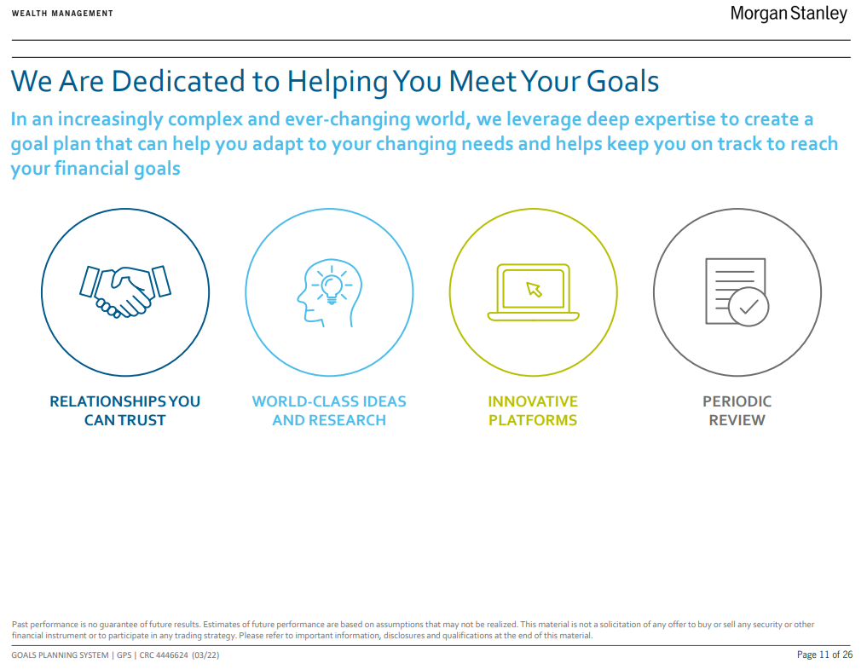

Slide 13
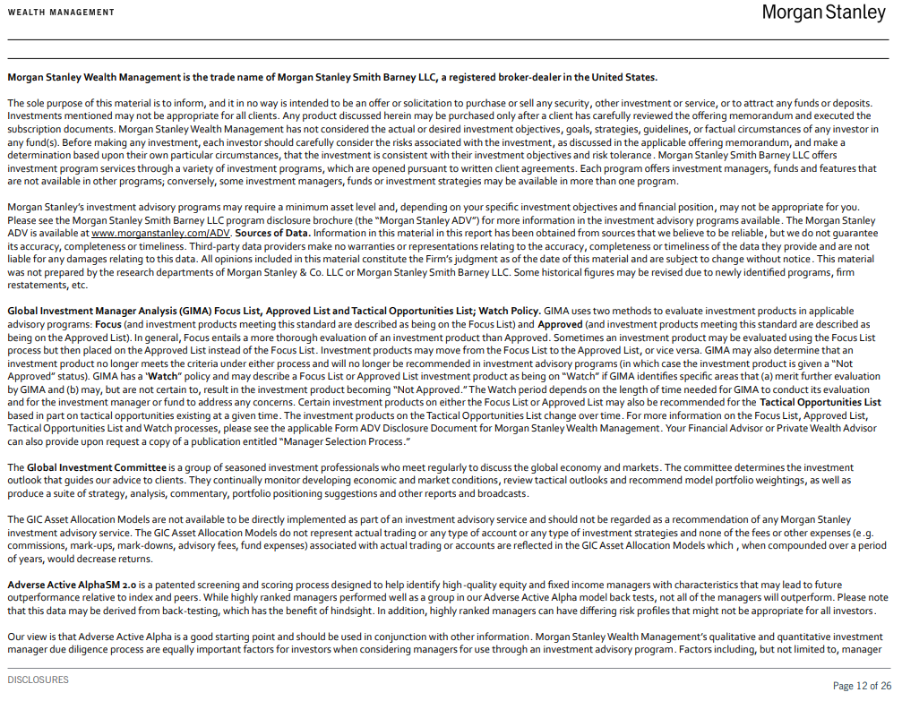

Slide 14
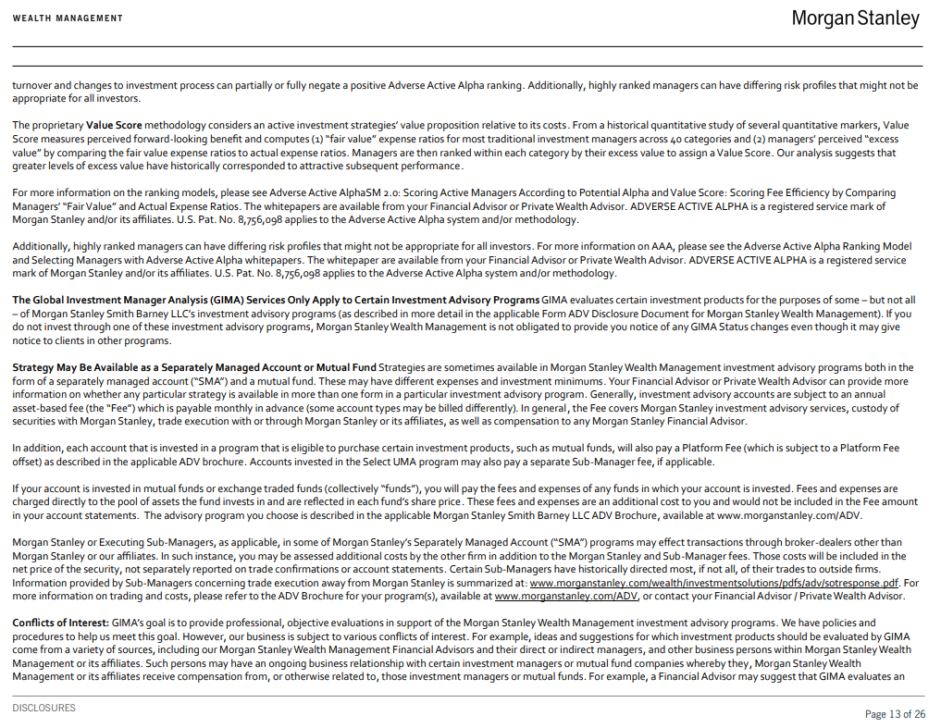

Slide 15
