Slide 1





Building Your Estate Planning Practice
Handout materials are available for download or printing on the HANDOUT TAB on the gotowebinar console. If the tab is not open click on that tab to open it and view the materials.
4

Slide 2
Building Your Estate Planning Practice: Marketing Services to Clients Not Paying Estate Tax

Slide 3
General Disclaimer
The information and/or the materials provided as part of this program are intended and provided solely for informational and educational purposes. None of the information and/or materials provided as part of this power point or ancillary materials are intended to be, nor should they be construed to be the basis of any investment, legal, tax or other professional advice. Under no circumstances should the audio, power point or other materials be considered to be, or used as independent legal, tax, investment or other professional advice. The discussions are general in nature and not person specific. Laws vary by state and are subject to constant change. Economic developments could dramatically alter the illustrations or recommendations offered in the program or materials.

Slide 4
Webinar
Speakers
Martin Shenkman, Esq., and Valentino Sabuco, CFP®, Executive Director for The Financial Awareness Foundation that has helped pioneer the ‘fee-only’ financial planning profession over the last 40 years as a principle of CPA firms, through his private practice, syndicated columns, and publishing activities.
Sponsors
Peak Trust Company - https://www.peaktrust.com/
Interactive Legal - https://interactivelegal.com/
The Financial Awareness Foundation - http://www.thefinancialawarenessfoundation.org/index.html

Slide 5
Objectives
This program is designed for practitioners (estate planners, attorneys, wealth advisers, insurance brokers, etc.) and will address how advisers can educate current and prospective clients on the importance of financial, and estate planning. This Webinar will present and discuss a consumer PowerPoint webinar which can be used in this process. The objective of the program will be to guide practitioners on how to market their services, especially at a time when many consumers mistakenly believe that estate planning is not relevant or not important because of the high tax exemptions.
The handout materials include the actual PowerPoint which practitioners can customize and use in marketing their practices.
Our co-sponsor The Financial Awareness Foundation is a 501(c)(3) nonprofit whose mission is to significantly help solve a major social problem dealing with a lack of financial awareness along with the financial illiteracy epidemic. They help motivate, educate and encourage consumers to get and keep their financial house in order by having current financial and estate plans. They’ll introduce you to The Improving Financial Awareness & Financial Literacy Movement and share resources they make available to practitioners to help grow your practice while solving the financial illiteracy epidemic.
Learn about The Improving Financial Awareness & Financial Literacy Movement
1. The Improving Financial Awareness & Financial Literacy Movement Report & Magazine™
http://www.thefinancialawarenessfoundation.org/pdf/TFAF-FallCampaignReport&Magazine.pdf
2. How Improving Financial Awareness & Financial Literacy Can Increase Your Bottom Line
http://www.thefinancialawarenessfoundation.org/pdf/TFAF-AdvisorsSupport-ImprovingFinancialAwareness-CanIncreaseYourBottomLine.pdf

Slide 6
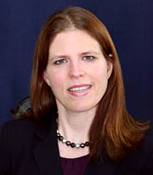



Thank you to our sponsors
InterActive Legal
Vanessa Kanaga
(321) 252-0100
sales@interactivelegal.com

Slide 7


Thank you to our sponsors
Peak Trust Company
Brandon Cintula
(888) 544-6775
bcintula@peaktrust.com

Slide 8

Estate Planning in 14 Steps
For Consumers
(Not Subject to the Federal Estate Tax)
By: YOUR NAME/FIRM NAME

Slide 9
Caveat
Nothing in these slides or any accompanying presentation is to be considered tax, legal, investment or other professional advice. The information is merely provided for educational purposes and no action should be taken without the individual consulting his or her own tax, estate, legal, financial, investment, insurance and other advisers.

Slide 10
What is Estate Tax Planning?
Estate planning had often been focused on minimizing estate taxes which were viewed as potentially devastating 50% + of what wealth you accumulated. For most taxpayers this is no longer the case.
For many consumers this translated into bypass trusts, marital trusts and insurance trusts. Even if these steps still make sense the focus of planning and application of those techniques has changed.
Now only about 3,000 decedents a year will pay estate tax:
$10 million inflation adjusted exemption (2019 – an individual can give $11.4 million and a couple can bequeath $22,800,000 without federal estate tax).
Caution: Democratic Presidential hopefuls have proposed harsh changes that could reduce the gift exemption to $1 million and the estate tax exemption to $3.5 million ($2.5 million if you use the entire $1 million gift exemption). So all of this may change and many people may again need to address planning.
A surviving spouse can capture (“port”) the exemption of the deceased spouse without a bypass trust.
Wealthier taxpayers might use many different planning techniques to reduce possible estate taxes, but that is beyond the scope of this presentation.

Slide 11
What is Estate and Financial Planning?
Providing peace of mind for you and your loved ones on a broad range of planning issues.
Addressing human planning issues: religious considerations, health challenges, charitable giving, and much more.
Financial planning, longevity planning and other financial decisions must lead most estate planning decisions. This includes investment planning, budgeting, and an array of different steps to holistically protect you and your loved ones.
Protection from lawsuits, creditors, divorce, identity theft, and other predators.
Insurance of varying types to meet many planning needs.
An integrated plan that coordinates your investments, retirement, insurance, emergency and disability planning, and more while you are alive, if you are disabled, when or if you are retired, and eventually for your heirs, charities and others you wish to benefit.
Maximize the increase in income tax basis (the amount on which capital gain is determined when an asset sold (called basis step-up) for income tax purposes.
Dealing with incapacity, especially if you are a business owner.
Estate planning will be different for each person and family. You have to define what “estate planning” means to you so that YOUR goals will be met.

Slide 12
Overview of Your Estate Planning – A Document Perspective
Powers of Attorney
Springing vs. not.
General vs. Special.
Why standard forms aren’t sufficient.
Special provisions to include.
Living Wills
What they are and why they are important.
Address specific health and religious issues.
HIPAA Releases
Health Proxies
Special considerations in selecting agent.
POLST
Insurance Trusts
Multi-purpose ILIT or MILIT.
Wills and Revocable Living Trusts
New Bypass trusts.
Boilerplate forms rarely address nuances needed.
What can and should you have.
Notes:
www.RV4TheCure.com
12
Comment: The documents and much of the planning for a client with chronic illness is similar and based on the same “building blocks” as any planning. But some creative modifications to tailor the documentation and planning to the particular client’s situation can be very beneficial.

Slide 13
How Financial and Estate Non-Tax Planning Have Changed
Technology has and is improving
You can get a wealth of information and even legal documents on line, but how can you protect yourself from what is worthwhile and what isn’t? As you will learn a document is only a part of what you will need.
More options
There are many different types of financial advisers, trust companies and investment options.
These can be integrated with your estate planning and create safer and better results.
Demographic changes
The aging population requires a focus on later life (longevity) planning to protect people as the age from elder financial abuse, identity theft, challenges of chronic disease and more.
20% of boomers support an elderly parent, many support adult children. How does this impact your planning?
Diversity expanding
Addressing different financial, religious and other considerations in planning and documents.

Slide 14
Income Tax Planning is Part of Financial and Estate Tax Planning
The income tax is the new estate tax.
Saving estate tax is not the focus for even most wealthy people. Income tax planning is now a critical component of estate planning and you need the right professional guidance to take advantage of these opportunities. Everyone may benefit.
Capital gains costs to your heirs may outweigh state estate tax costs so maximizing “basis step-up” (adjust tax “cost” to fair value on death) may be more important than estate tax savings.
Do your LLCs and partnerships permit you to obtain a basis step up by making a 754 election?
Do your irrevocable trusts have swap powers?
Partnerships and irrevocable trusts can be used to shift income to lower bracket taxpayers (e.g. adult children not subject to the Kiddie Tax).

Slide 15

Introduction to the 14 Steps of Estate and Financial Planning
Every person is unique – it has to be your plan and address your goals.
Reflect your personal wishes and circumstances.
Create a strong financial foundation, an integrated plan, and documents to build upon.

Slide 16
Step 1: Organize Emergency, Financial, Information and Advisors Information
Contact People (names, numbers).
Financial Information (account information).
Passwords and Security Codes.
Documents (Estate planning documents, legal documents, and more).
Budget and Financial Plan.
Tax Basis Information.

Slide 17
Investment and Financial Information is Critical to Organize and Communicate
Title to Accounts
Your name alone.
Revocable trust.
Joint.
Other (POD, TOD, etc.)
Beneficiary designations
Update for new laws (e.g. remove bypass trusts).
For your assets.
Should trusts be named?
Of others that benefit client living with chronic illness.
Account Management
Duplicate statements.
Consolidation and simplification.
Asset location decisions.
Access to safe deposit box.
Automation
Organizing records.
On line payments.
Automatic deposits.
Paperless.
Notes:
www.RV4TheCure.com
17
Comment: Most practitioners will find each of these points quite basic, but the valuable lesson is to assure that practitioners address each appropriate item with each client. Often simple and basic steps, like getting a duplicate monthly statement sent to a child, can save the day.

Slide 18
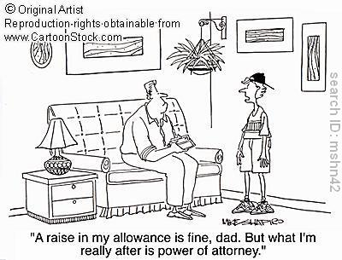
Step 2: Designate a Person to Handle Financial and Legal Issues
Power of Attorney
Agent (Successors).
Compensation.
Begin date (Trigger).
Powers (Authority).
Durability (Disability).

Slide 19
Powers of Attorney Decisions
Who should be named agent? What if you don’t have reliable people? Worse, what if you think you have reliable people but you don’t?
Gift powers have been standard. Should they be? Might it be safer, to prevent elder financial abuse, to prohibit gifts?
More complex tax powers for the wealthy and even others:
What about gifts of remaining gift tax exemption?
The right to continue your pattern of charitable giving?
Consider practical steps to make the power of attorney effective.
Just having a document is not enough to protect you.
Consolidated and simplify financial holdings.
Organize and automate records.
Bills and deposits on automatic.

Slide 20
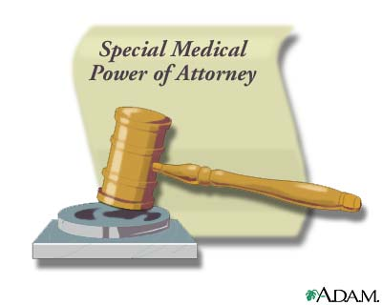
Step 3: Designate a Person to Make Health Care Decisions and Access Medical Records
Health Care Proxy
Medical Power of Attorney
Agent (successors).
Powers (religion).
Signature (State law).
Move (state; facility).
HIPAA Release.

Slide 21

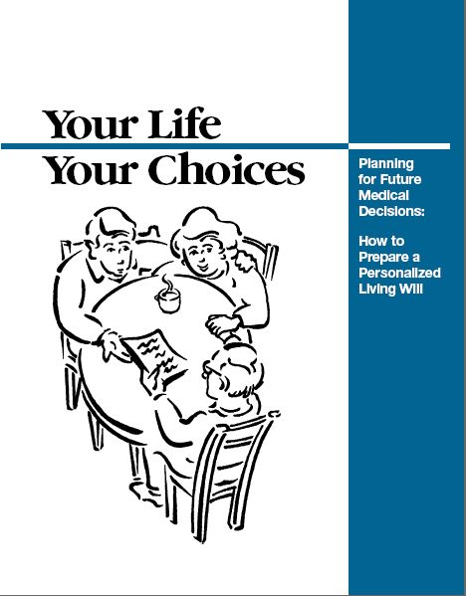
Step 4: Other Health Care Documents
Prepare a Living Will

Slide 22
Health Care Document Considerations
HIPAA Release (Health Insurance Portability Accountability Act) – authorizes someone to access medical records and speak with physicians.
Living Wills – Statement of health care wishes.
Address end of life decision making, funeral/burial.
Organ donations.
Nutrition and hydration.
Specify religious considerations.
POLST (Physician Order Life Sustaining Treatment) – permitted in more than 40 states. A statement in your patient chart prepared by your physician to govern end of life decisions.

Slide 23

Step 5: Planning For Minor Children
Disclose a child’s care information.
Plan for medical emergencies.
529 plans.
Trust for child in your will.

Slide 24
Planning For Children
How do you define “children” in your legal documents? Does that include those you want, but exclude those you don’t want provided for? Consider adopted children, out of wedlock, reproductive technologies, etc.
Should you take special precautions in your planning for a special needs child? Be certain planning for a special child contemplates your disability, the child’s unique circumstances, and potential changes.
How do you plan for boomerang children (adult children who move back home)? Do you permit their support? How much? What about other children?
How do you factor in current or future assistance for children (even adult children) into your financial plan?
Do you have adequate life and disability insurance to protect your children?

Slide 25
Planning For Children
Why ever set up a child or grandchild’s trust? Does it ever make sense? In many cases a trust for your spouse/partner and all children and descendants may be more advantageous. Why leave out your spouse? What if you need access to the money?
Modern trust drafting:
Create a dynastic trust to benefit spouse and all descendants. Why lose ability to benefit as it provides no tax or asset protection advantage?
Broad class of beneficiaries to maximize income tax shifting?
Creative use of general powers of appointment to maximize basis step up.
Powers of appointment, decanting provisions, trust protectors, and more techniques to add flexibility.
New positions/roles: trust protectors, loan directors, administrative trustees, etc.

Slide 26

Step 6: Sign a Will
A legal document to designate
where your assets should
be distributed in the event of death

Slide 27
Wills – Not The Only Document to Consider
Most consumers focus on the contents of their wills. While this is appropriate for many people, consider that many (even most) of their assets may pass outside of their will. This could be based on:
Beneficiary designation forms (e.g., for your IRA and life insurance.)
On how accounts are owned (titled) (e.g., a bank account that is Pay On Death to a child, joint accounts, etc.)
On legal documents (e.g., a deed that has your house owned jointly with a spouse or an heir.)
Coordinate all of these different “transfers” to be sure your intent is really met. This is just one critical example why merely procuring a will or other document often won’t address your real planning needs. You need a more comprehensive approach.
Few consumers understand the implications of title and beneficiary designations and too often neglect the importance of their other planning. Ideally, all of this should be confirmed and coordinated with your financial adviser/investment firms.

Slide 28
Wills – If Your Wealth Increases or Circumstances are Complex?
Consider using a revocable trust as your primary document.
Do not rely automatically on testamentary dispositions under your will. Consider instead making gifts or even creating more robust lifetime trusts in a trust friendly jurisdiction like Delaware.
Bypass trusts – Consider new powers to distribute capital gains as part of trust accounting income, powers of appointment to cause estate tax inclusion, naming broader class of beneficiaries to shift income to lower brackets, and more.
QTIP Trusts – plan for 2519 disclaimer, or even a so-called “Clayton QTIP” rather than disclaimer, for more flexibility and perhaps tax benefits.
Investment allocation permitted to consider overall family investment allocation and tax status of each trust so can maximize tax and other benefits.

Slide 29


Step 7: Create a Revocable Living Trust
Establish a personalized living trust.
Transfer assets to a trust during your lifetime.
Manage assets as you age or during disability or illness.
It should be about much more than avoiding probate.

Slide 30

Step 8: Be Sure Your Insurance Coverage is in Order
Property and casualty insurance.
Liability insurance.
Long term care coverage.
Disability income replacement.
Life insurance.
Liability.

Slide 31
Life Insurance
Do you have a reasonable amount of life insurance to cover your real needs? Too much diverts money that you could add to savings. Too little may leave your loved ones in financial hardship.
Your circumstances and needs change over time. Review existing policies and coverages with an insurance expert. Do they still meet your current needs? Can you change them to better serve your goals?
Consider using permanent life insurance as an asset class – part of your investment strategy + income tax benefits.
Long-Term care coverage may be a special type of life insurance policy.
Other creative uses of life insurance.

Slide 32
Life Insurance Trust
Life insurance coverage on your life could be part of a plan to protect your assets, your spouse/partner, or others.
Life Insurance Trust:
Life insurance, because of the dollars of coverage and importance often should be held in a trust to protect it.
Instead of a simple life insurance trust use a more robust trust that accomplishes multiple goals, a Multi-purpose Irrevocable Life Insurance Trust.
Simplified Crummey powers.
Hold other assets in the same trust. Income from those assets can be used to pay insurance premiums.
Asset protection when it is really needed.
Review and repurpose existing policies and ILITs.

Slide 33

Step 9: Beneficiary Designations
Standard provisions are not always adequate.
Coordinate with Revocable Trust.
What powers should agent have.
Give copies to your advisers.
Update when banks merge.
Revise when tax laws change.
Should you ever name bypass trust.
5-10 year payout may become law.

Slide 34

Step 10: Matrimonial Planning
Protect heirs with trusts instead of outright gifts or bequests.
Create or review prenuptial agreements.

Slide 35

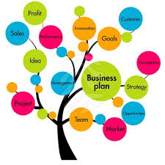
Step 11: Business Planning
Proper entities to minimize liability exposure for personal assets.
Business formalities.
Succession planning.
Integrate planning for your business into your estate plan.

Slide 36

Step 12: Give Back
Demonstrate important values to heirs.
Thank those that have helped.
Inspire others to give.

Slide 37
Charitable Giving Should be About More than Taxes
Giving back, by volunteering, donating things you don’t need, writing a check, or using more sophisticated techniques.
Permit trustees and agents to make contributions to teach values to heirs.
Harvesting gains and losses each year to minimize the amount taxable.
2 Generation CRUT for IRA.
Why ever make a bequest under your will to charity? It might be a good way to demonstrate values for your heirs but giving while you are alive may generate a better tax break.

Slide 38

Step 13: Communicate
Educate and inform your fiduciaries (agents, trustees).
Preparation of beneficiaries.
Advisory team must cooperate.
Having a real conversation is one
of the most important steps you can take

Slide 39
Communication
Family, loved ones, people you named to fiduciary positions – all need to be informed of your plan and understand its relevance to them.
A team approach is more vital than ever before – especially for those advancing in years or facing a health challenge.
If you cannot afford a meeting with a CPA, attorney, investment adviser and insurance consultant you can achieve similar results in an affordable manner.
Integrated planning is the only approach to succeed.
Every adviser brings something to the table.
Everyone at every wealth level needs checks and balances. Use advisers, family members, etc.
Planning is more complex than ever before so efficient planning team operation is vital.
Broaden the concept of who should be part of your team.

Slide 40

Step 14: Review, Revisit, Revise
Nothing remains static
Tax and property laws.
Family situations.
Assets and net worth.
Health.
Feelings.

Slide 41
Annual Reviews with your Team are Vital
All insurance must be reviewed and managed.
If you have a bad egg as an agent or adviser it is the regular interaction of your team that will help identify it.
Coordinating the complex interplay of income and estate taxes, asset protection, and other goals will never work without regular checkups – this is important especially for those with lesser wealth since a loss will have a more adverse impact.
You change oil every 5,000 miles and go to your doctor for an annual physical, you had best meet your advisers once a year too.
Web meetings and other technology can make it quite cost effective.

Slide 42

Make an Action Plan
And Get Started

Slide 43
Action Steps
If you haven’t met with your CPA to discuss anything other than a tax return in the last year, call him/her now.
If your life insurance has not been reviewed in two years, call your insurance agent.
Do you know what your beneficiary designations say? Do you have current copies?
If you have not updated all of your estate planning documents in the past two years, you’re overdue for a review.
Have you reviewed all existing/old entities and trusts?
Have you considered practical steps to make your documents function?

Slide 44
For More Information
Your contact data here.

